Slide 1
Table of Contents

Slide 2
Problematique
Kafka’s Origin and Use Case
Kafka architecture
Install Kafka server and zookeeper:
Binary,
Docker
Kafka manager
- With Cli
- With Conduktor
Kafka Server
- Details : Broker, Topic, Partitions
- Demo with UI Apache Kafka
Producer
- Details Producer
- Demo with UI Apache Kafka
Consumer
- Details Consumer
- Demo with UI Apache Kafka
Demo with Code source

Slide 3
Problemematique ???

Slide 4
Every enterprise is powered by data. We take information in, analyze it, manipulate it, and create more as output. Every application creates data, whether it is log messages, metrics, user activity, outgoing messages, or something else. Every byte of data has a story to tell, something of importance that will inform the next thing to be done. In order to know what that is, we need to get the data from where it is created to where it can be analyzed. We see this every day on websites like Amazon, where our clicks on items of interest to us are turned into recommendations that are shown to us a little later.

Slide 5
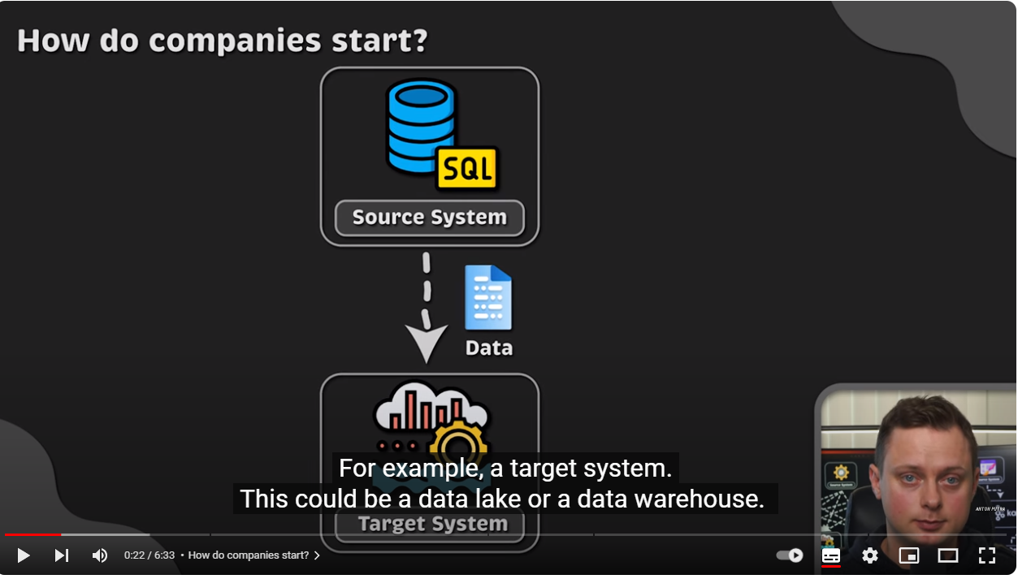

Slide 6
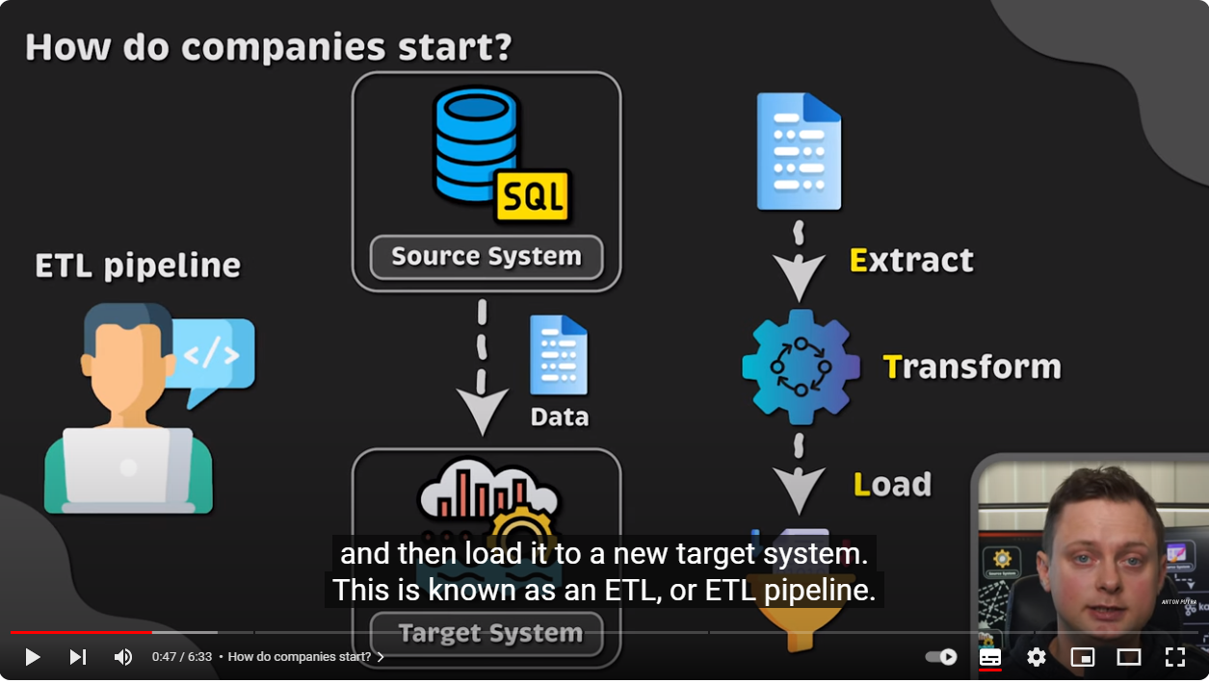

Slide 7
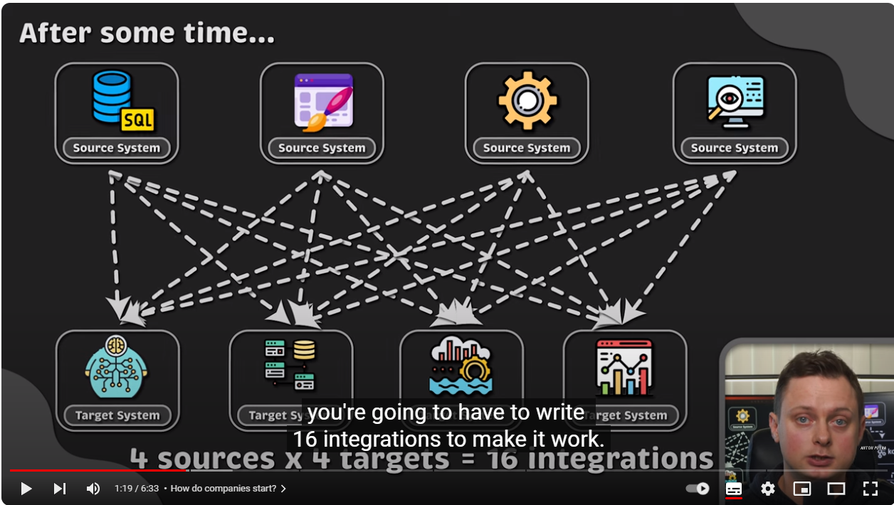

Slide 8
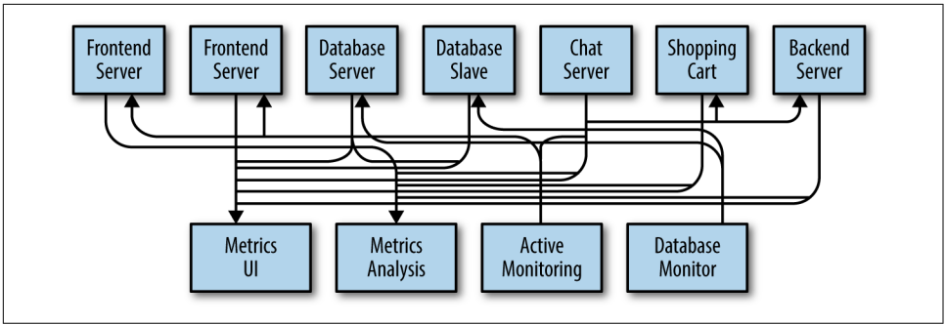

Slide 9
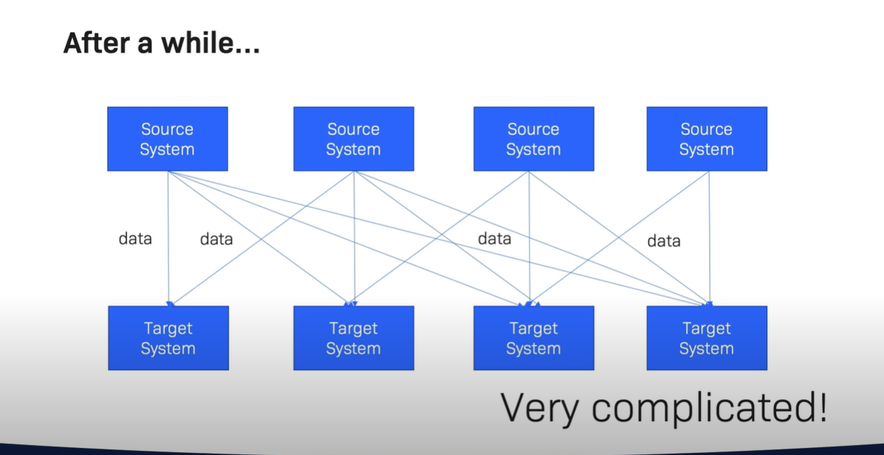

Slide 10
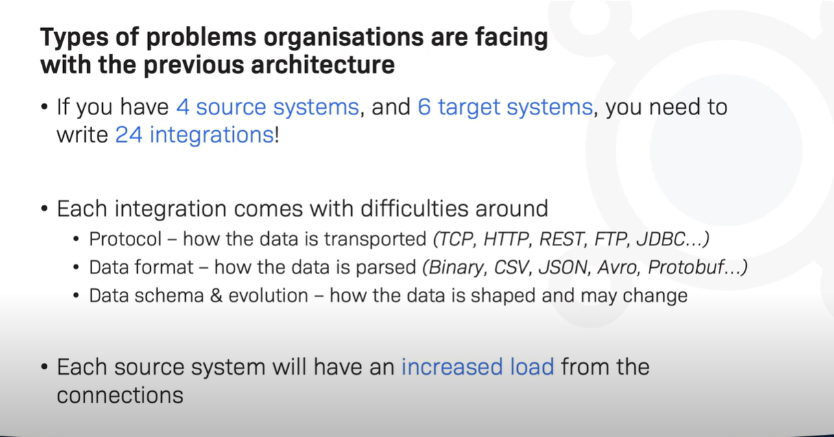

Slide 11
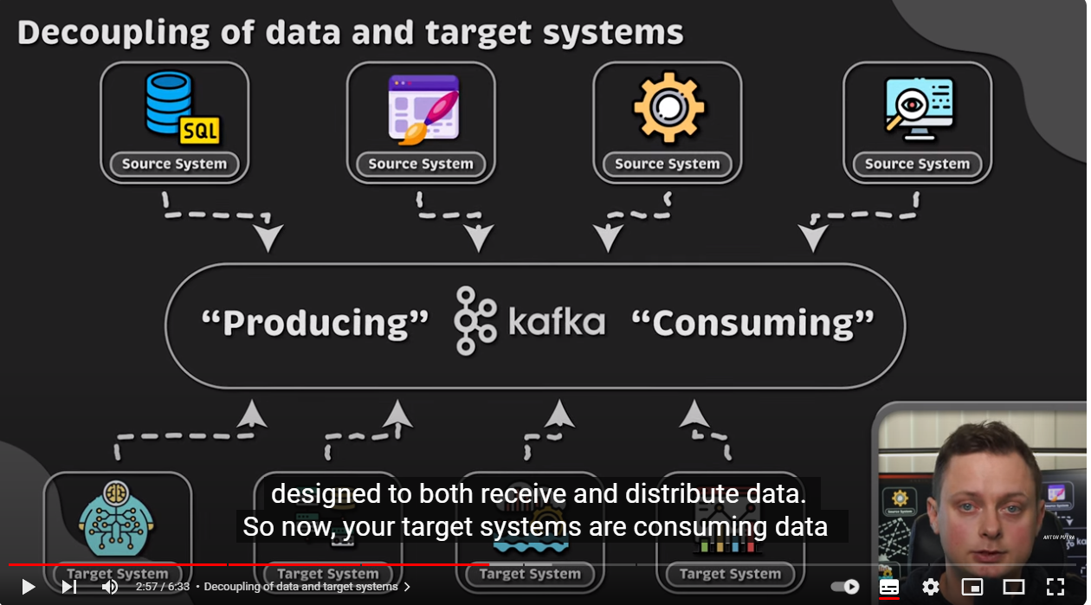

Slide 12
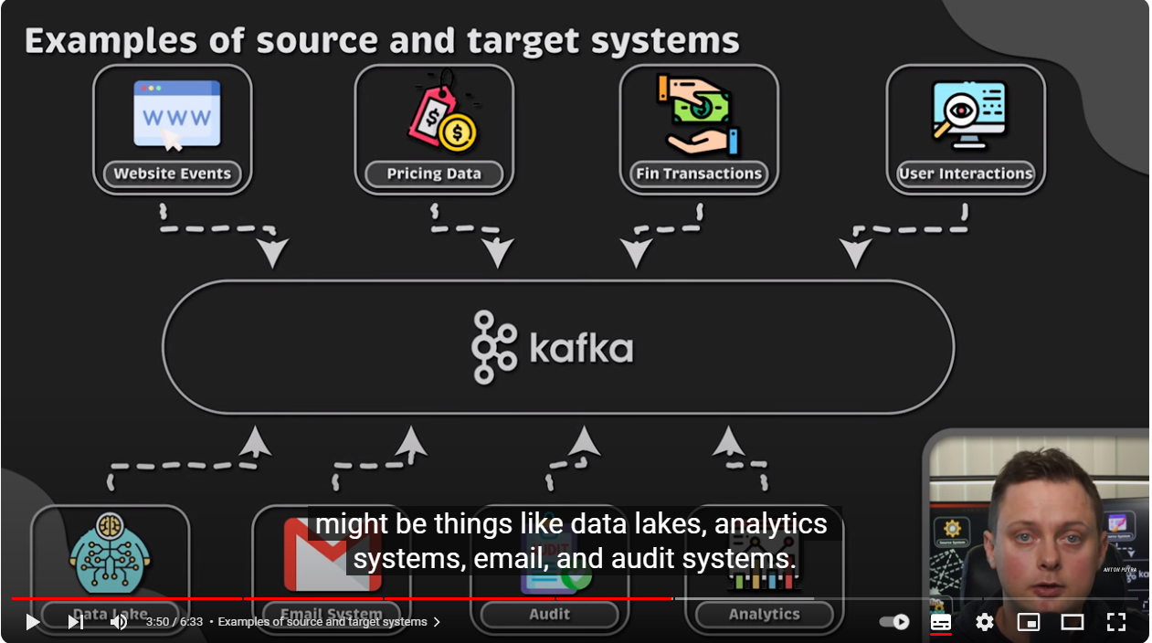

Slide 13
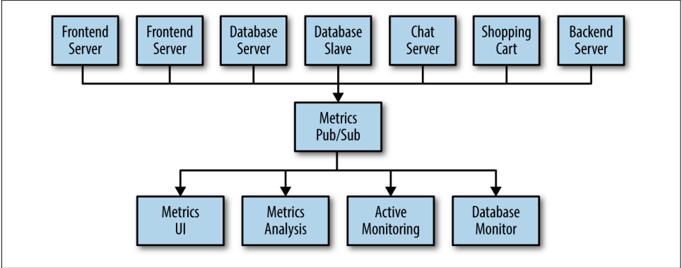
The technical debt built up here is obvious, so you decide to pay some of it back. You set up a single application that receives metrics from all the applications out there, and provide a server to query those metrics for any system that needs them. This reduces the complexity of the architecture to something similar

Slide 14
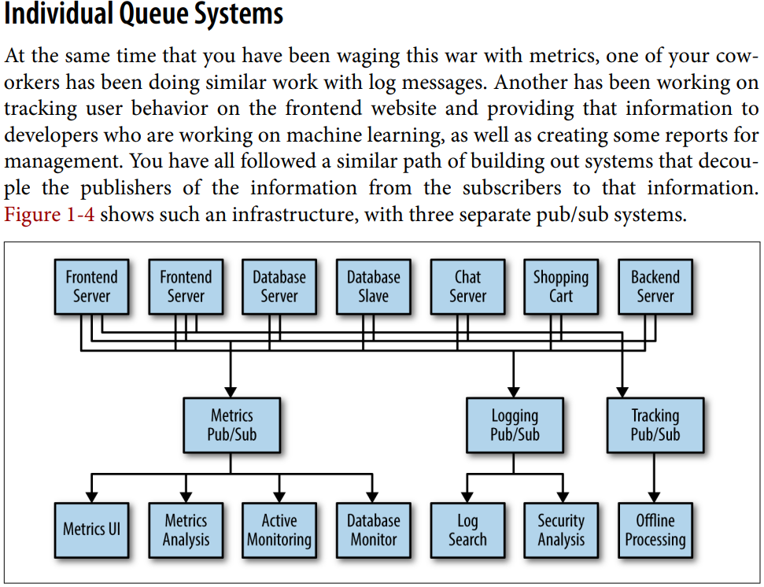

Slide 15
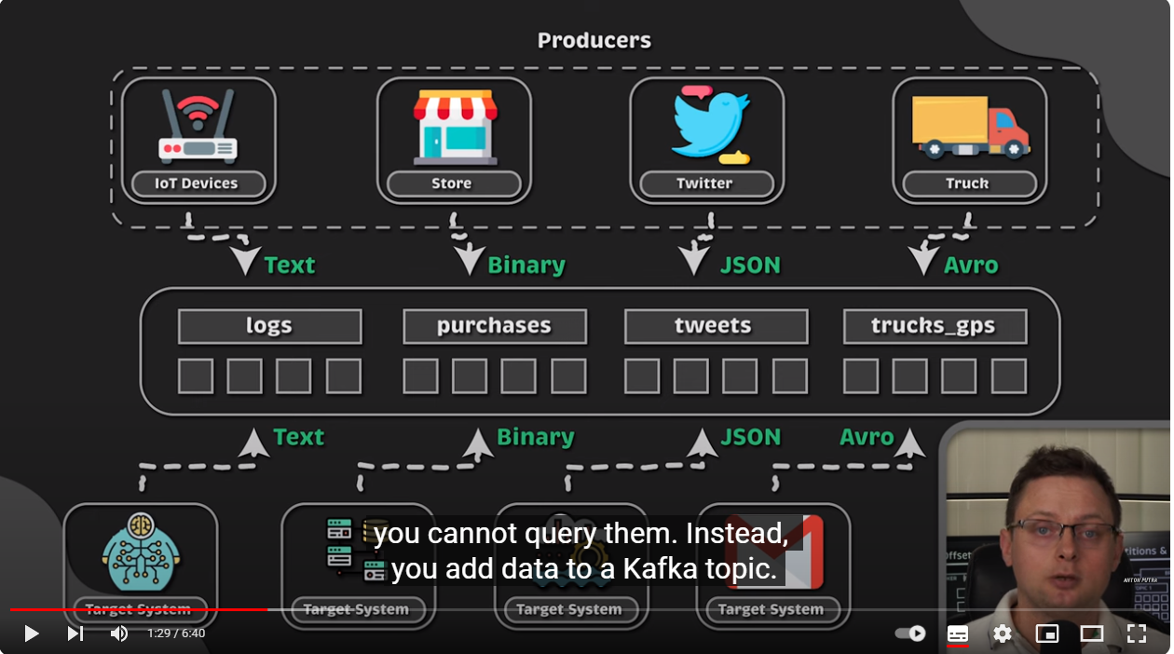

Slide 16
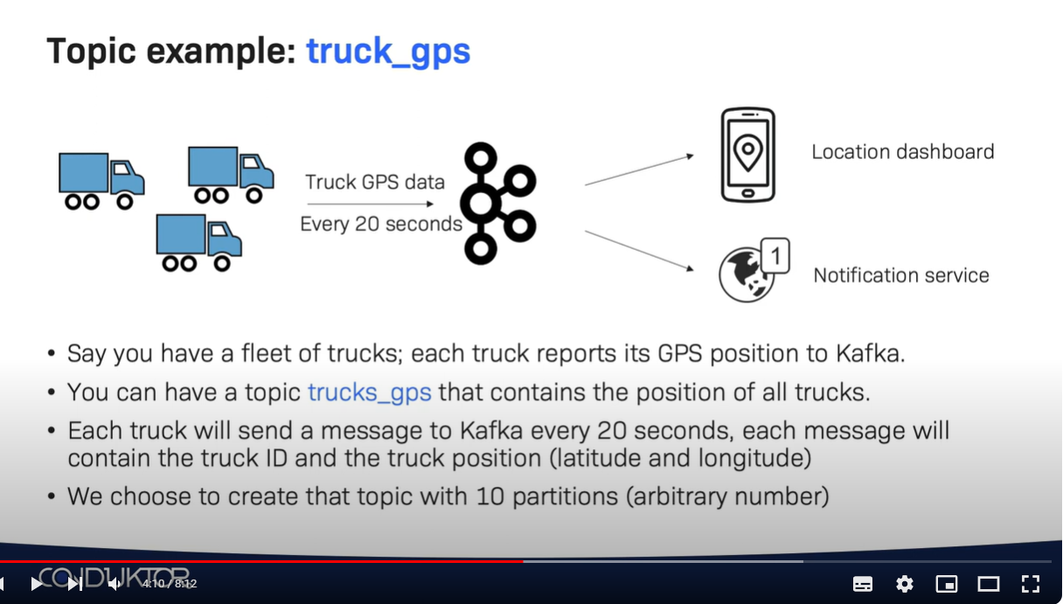

Slide 17
Apache Kafka is a publish/subscribe messaging system designed to solve this prob‐ lem. It is often described as a “distributed commit log” or more recently as a “distrib‐ uting streaming platform.” A filesystem or database commit log is designed to provide a durable record of all transactions so that they can be replayed to consis‐ tently build the state of a system. Similarly, data within Kafka is stored durably, in order, and can be read deterministically. In addition, the data can be distributed within the system to provide additional protections against failures, as well as signifi‐ cant opportunities for scaling performance.

Slide 18
Kafka’s Origin and Use Cases

Slide 19
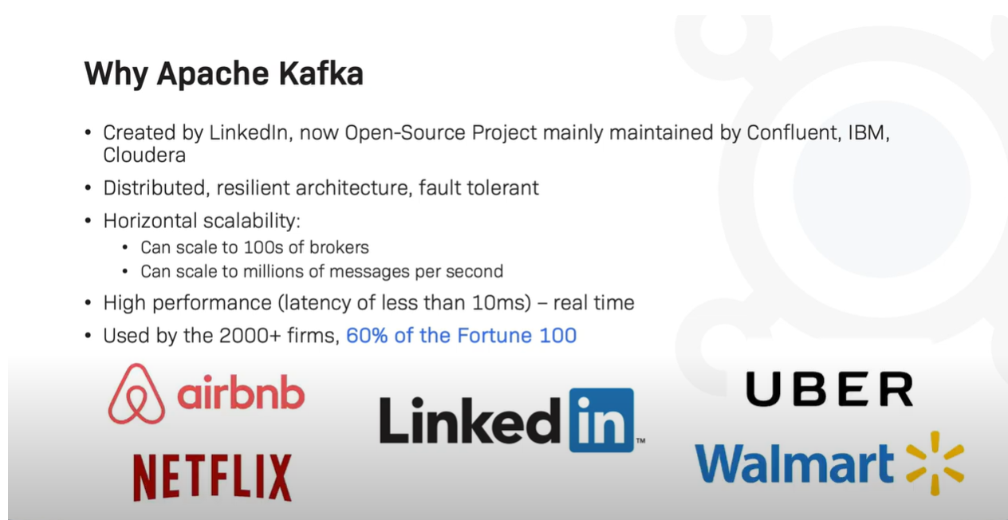

Slide 20
Why Kafka: what makes Apache Kafka a good choice ?
Multiple Producers:
Kafka is able to seamlessly handle multiple producers, whether those clients are using many topics or the same topic. This makes the system ideal for aggregating data from many frontend systems and making it consistent. For example, a site that serves con‐ tent to users via a number of microservices can have a single topic for page views that all services can write to using a common format. Consumer applications can then receive a single stream of page views for all applications on the site without having to coordinate consuming from multiple topics, one for each application.

Slide 21
Multiple Consumers:
In addition to multiple producers, Kafka is designed for multiple consumers to read any single stream of messages without interfering with each other. This is in contrast to many queuing systems where once a message is consumed by one client, it is not available to any other. Multiple Kafka consumers can choose to operate as part of a group and share a stream, assuring that the entire group processes a given message only once.

Slide 22
Scalable:
Kafka’s flexible scalability makes it easy to handle any amount of data. Users can start with a single broker as a proof of concept, expand to a small development cluster of three brokers, and move into production with a larger cluster of tens or even hun‐ dreds of brokers that grows over time as the data scales up. Expansions can be performed while the cluster is online, with no impact on the availability of the system as a whole. This also means that a cluster of multiple brokers can handle the failure of an individual broker, and continue servicing clients.

Slide 23
High Performance
All of these features come together to make Apache Kafka a publish/subscribe messaging system with excellent performance under high load. Producers, consumers, and brokers can all be scaled out to handle very large message streams with ease. This can be done while still providing subsecond message latency from producing a mes‐ sage to availability to consumers

Slide 24
The Data Ecosystem:
Kafka EcoSystem is formed with Kafka Core, Kafka Streams, Kafka Connect, Kafka REST Proxy, and the Schema Registry
When coupled with a system to pro‐ vide message schemas, producers and consumers no longer require tight coupling or direct connections of any sort. Components can be added and removed as business cases are created and dissolved, and producers do not need to be concerned about who is using the data or the number of consuming applications.

Slide 25
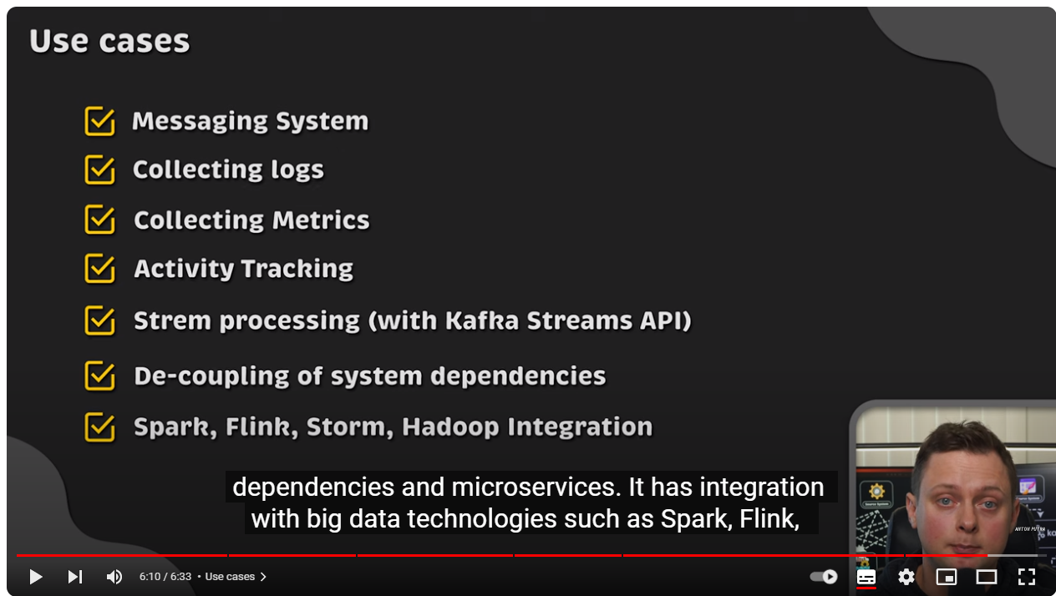

Slide 26
Use Cases
Messaging
Kafka is also used for messaging, where applications need to send notifications (such as emails) to users
Activity tracking
The original use case for Kafka, as it was designed at LinkedIn, is that of user activity tracking. A website’s users interact with frontend applications, which generate mes‐ sages regarding actions the user is taking. This can be passive information, such as page views and click tracking, or it can be more complex actions, such as information that a user adds to their profile. The messages are published to one or more topics, which are then consumed by applications on the backend. These applications may be generating reports, feeding machine learning systems, updating search results, or per‐ forming other operations that are necessary to provide a rich user experience.

Slide 27
Metrics and logging
Kafka is also ideal for collecting application and system metrics and logs. This is a use case in which the ability to have multiple applications producing the same type of message shines. Applications publish metrics on a regular basis to a Kafka topic, and those metrics can be consumed by systems for monitoring and alerting

Slide 28
Kafka architecture

Slide 29
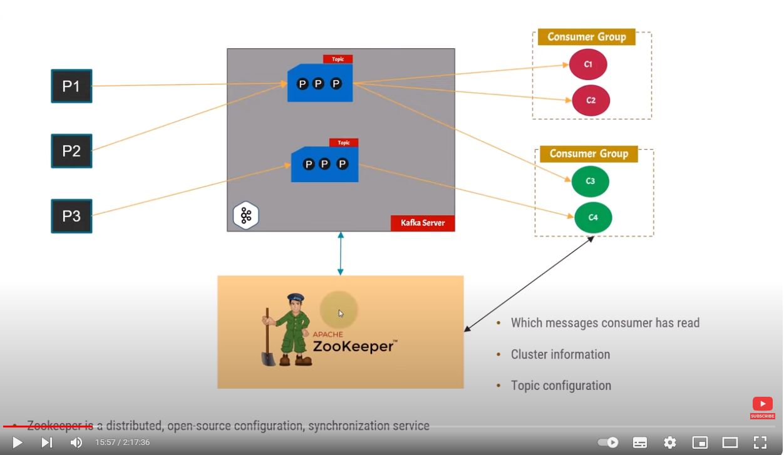

Slide 30
Save Data in another System
Trace Charts
Turn list of Recomendations
Send Notifs
Chat

Slide 31
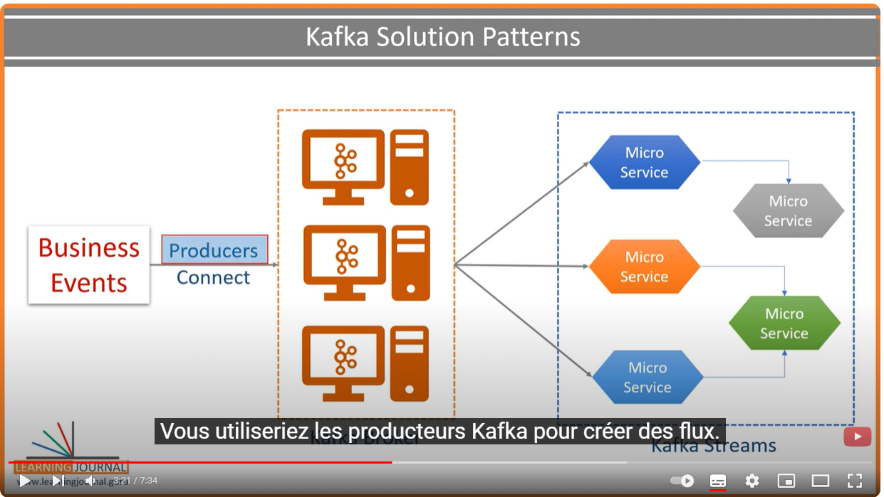

Slide 32
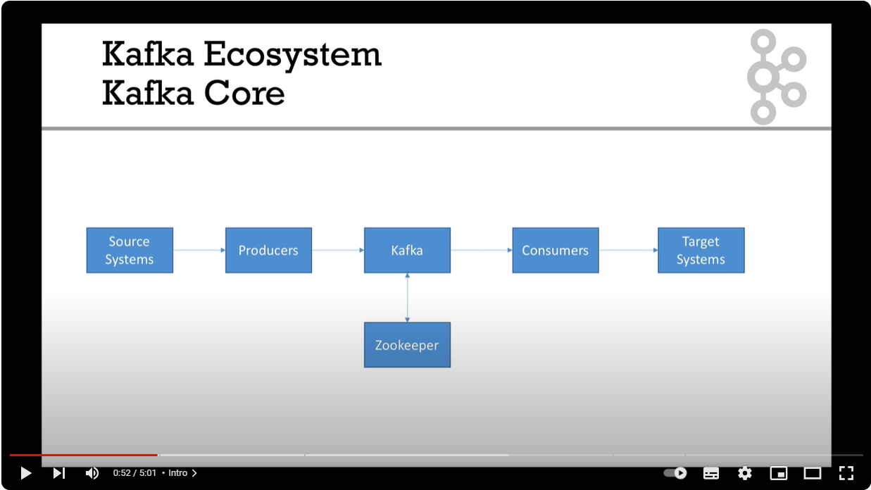

Slide 33
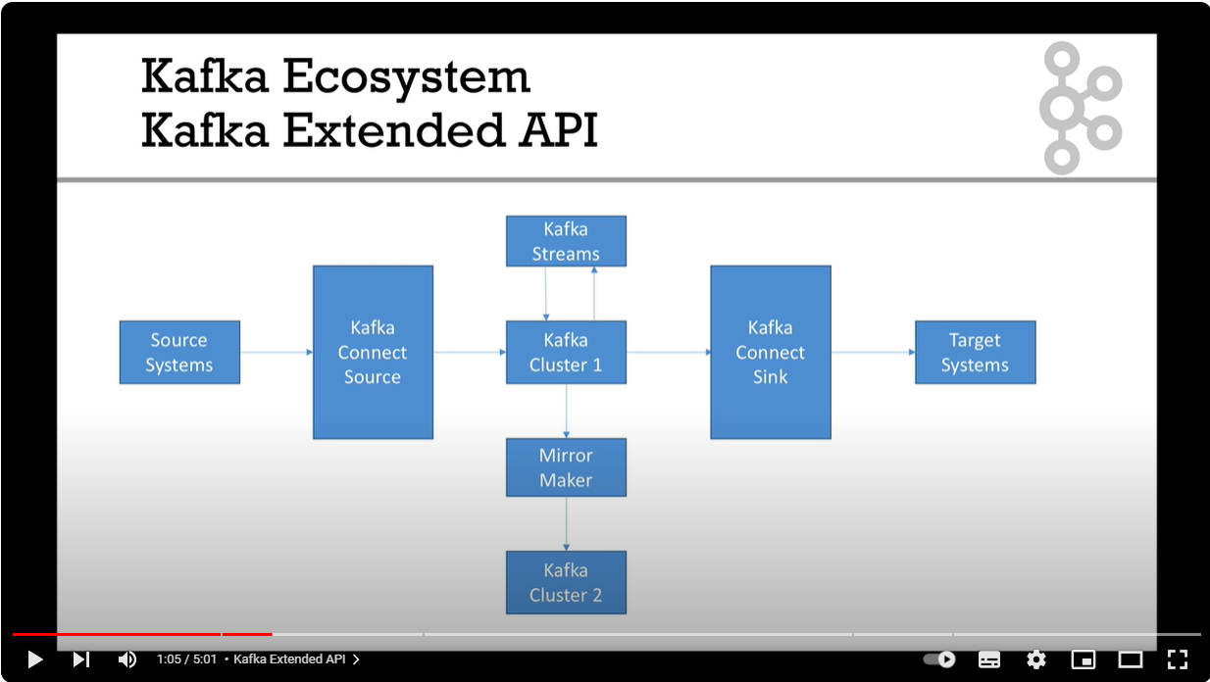

Slide 34
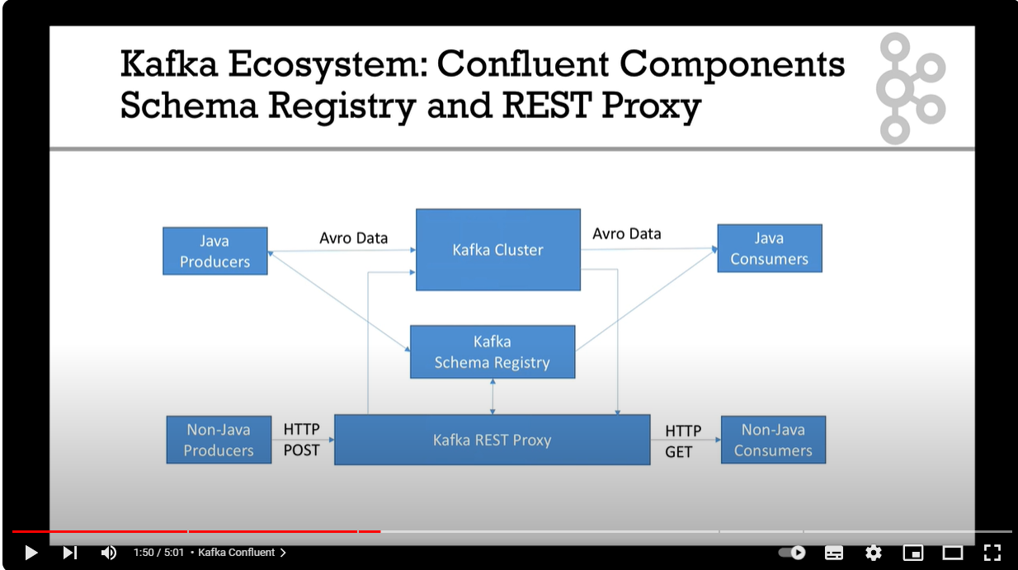

Slide 35
Publish/Subscribe Messaging
Publish/subscribe messaging is a pattern that is characterized by the sender (publisher) of a piece of data (message) not specifically directing it to a receiver. Instead, the publisher classifies the message somehow, and that receiver (subscriber) subscribes to receive certain classes of messages. Pub/sub systems often have a broker, a central point where messages are published, to facilitate this.

Slide 36
Install Kafka server and zookeeper

Slide 37
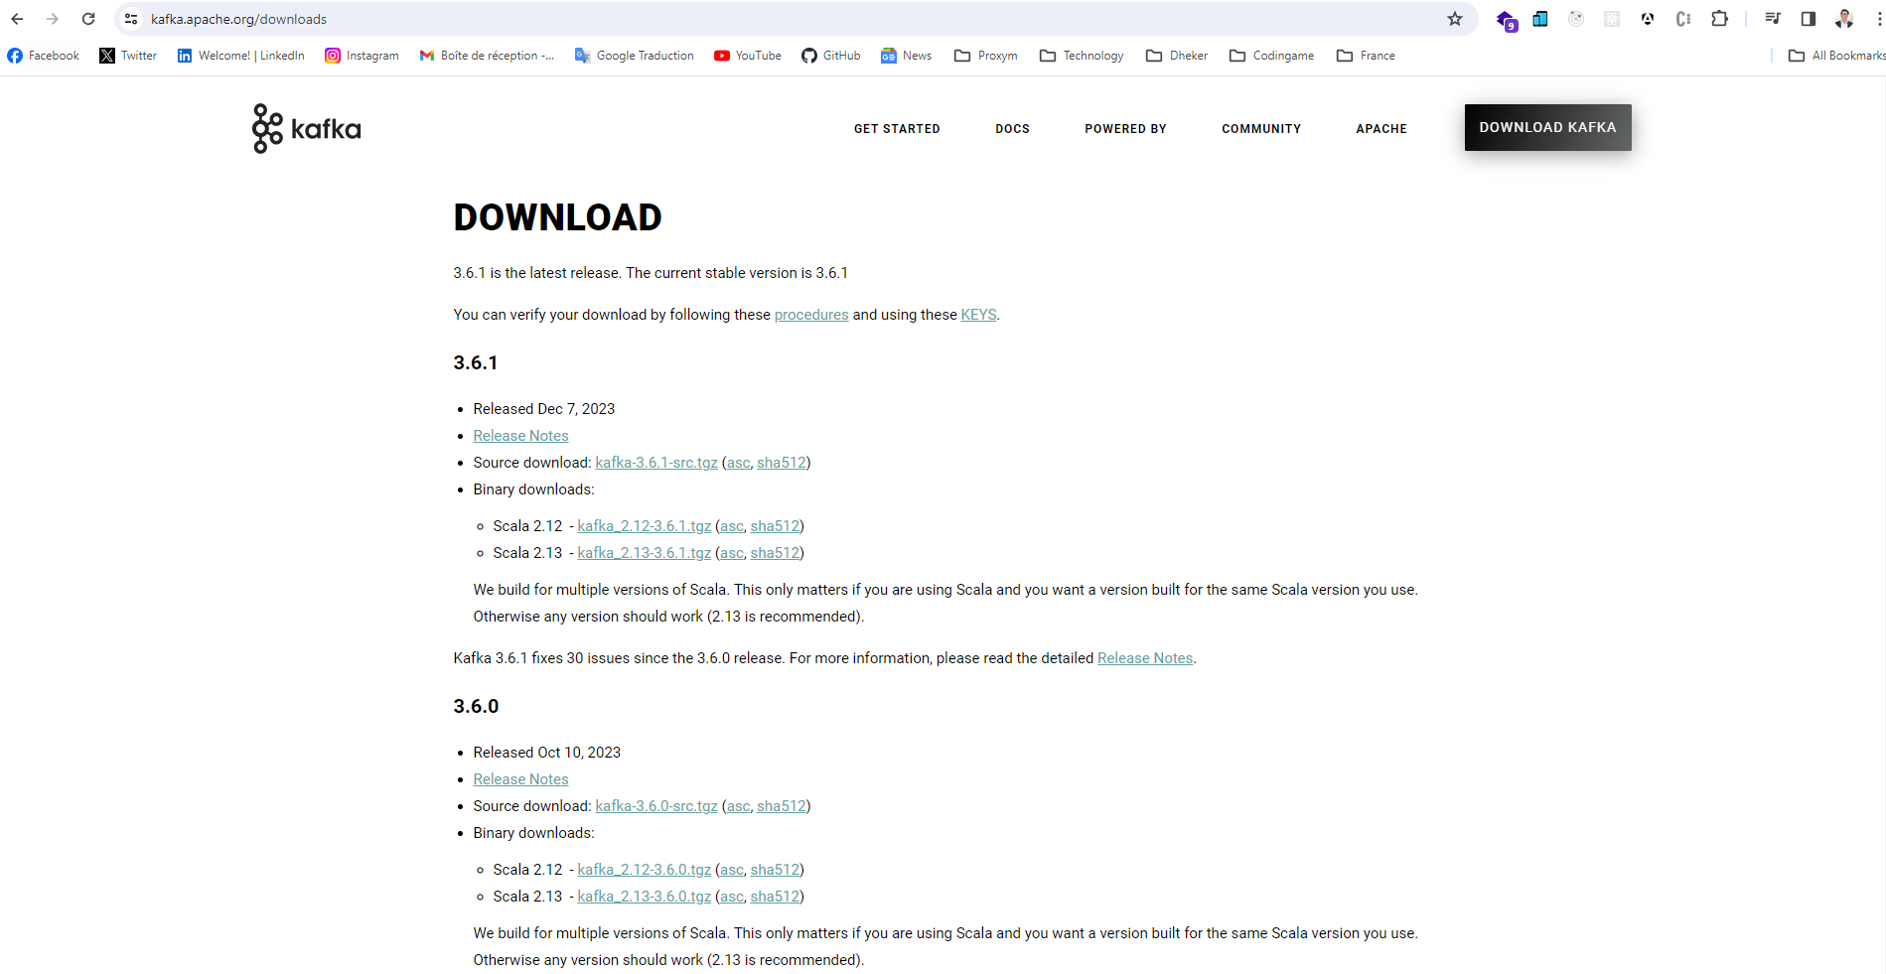

Slide 38
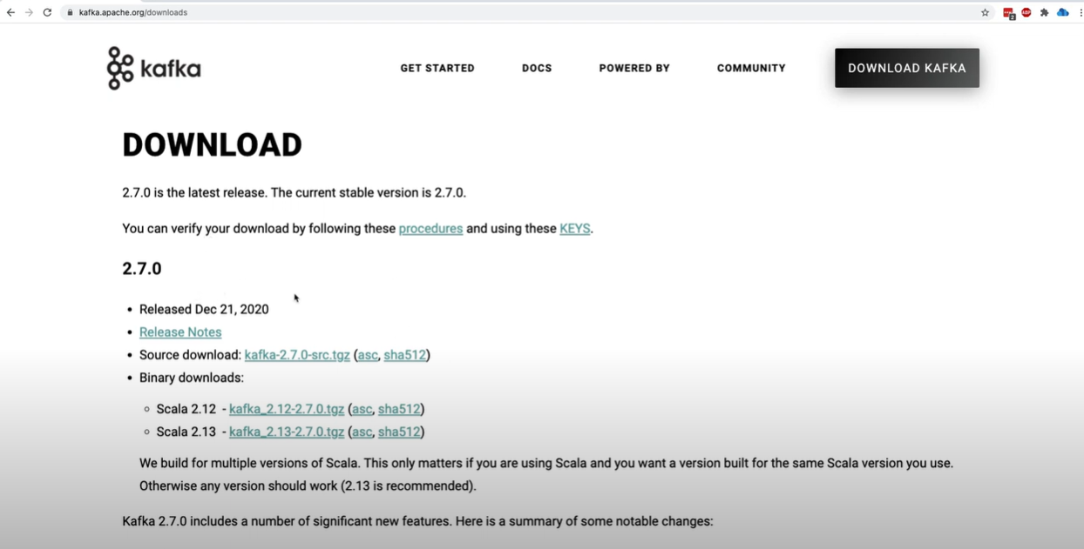
using the downloaded binaries (JVM)

Slide 39
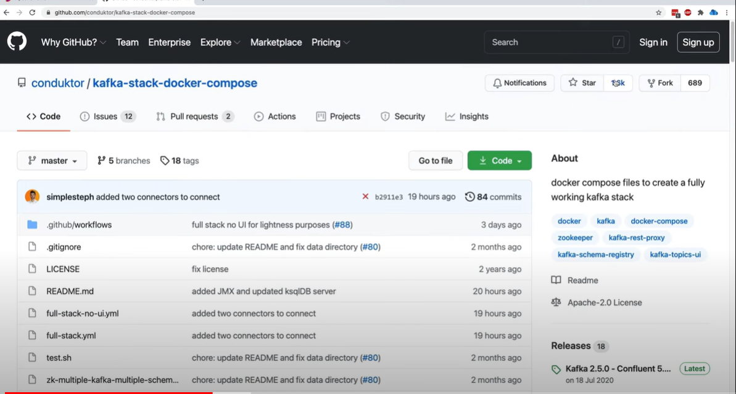
using Docker and Docker-Compose

Slide 40
Interaction With Kafka
Via CLI : ???
$ bin/kafka-console-producer.sh --topic quickstart-events --bootstrap-server localhost:9092
This is my first event
This is my second event

Slide 41
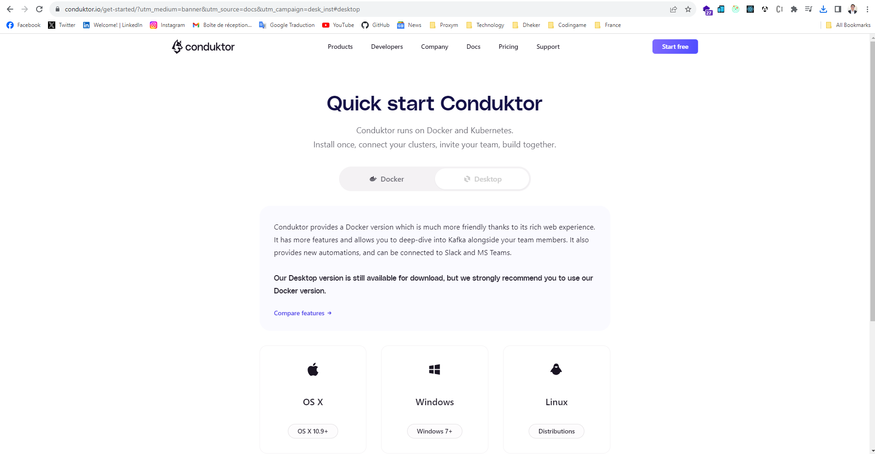
Graphical User Interface

Slide 42
Kafka Server

Slide 43
Topics and Partitions
Messages in Kafka are categorized into topics
The closest analogies for a topic are a database table or a folder in a filesystem
Topics are divided into a number of partitions
the “commit log” description: a partition is a single log.
Messages are written to it in an append-only fashion, and are read in order from beginning to end
Note that as a topic typically has multiple partitions, there is no guarantee of message time-ordering across the entire topic

Slide 44
The offset
The offset is another bit of metadata—an integer value that continually increases—that Kafka adds to each message as it is produced. Each message in a given partition has a unique offset. By storing the offset of the last consumed message for each partition, either in Zookeeper or in Kafka itself, a consumer can stop and restart without losing its place.

Slide 45
Brokers and Clusters
A single Kafka server is called a broker. The broker receives messages from producers, assigns offsets to them, and commits the messages to storage on disk. It also services consumers, responding to fetch requests for partitions and responding with the mes‐ sages that have been committed to disk. Depending on the specific hardware and its performance characteristics, a single broker can easily handle thousands of partitions and millions of messages per second.

Slide 46
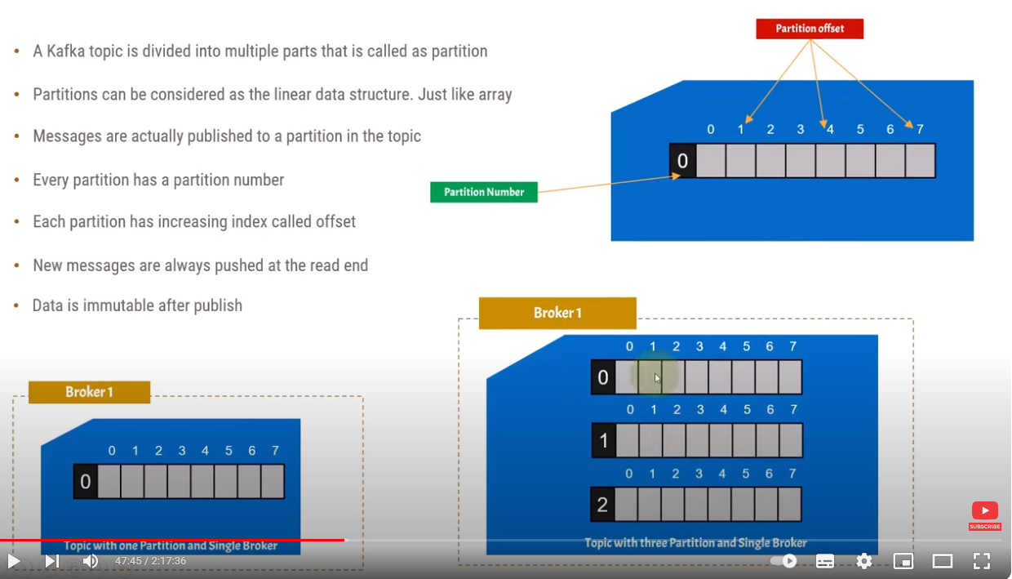

Slide 47
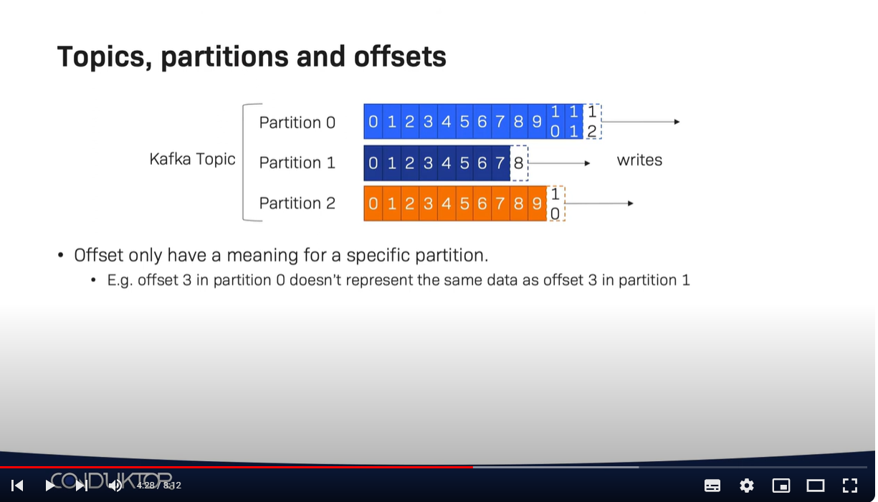

Slide 48
Topic Configurations
num.partitions: parameter determines how many partitions a new topic is created with, primarily when automatic topic creation is enabled (which is the default setting). This parameter defaults to one partition. Keep in mind that the number of partitions for a topic can only be increased, never decreased. This means that if a topic needs to have fewer partitions than num.partitions, care will need to be taken to manually create the topic
Partitions are the way a topic is scaled within a Kafka clus‐ ter, which makes it important to use partition counts that will balance the message load across the entire cluster as brokers are added. Many users will have the partition count for a topic be equal to, or a multiple of, the number of brokers in the cluster. This allows the partitions to be evenly distributed to the brokers, which will evenly distribute the message load. This is not a requirement, however, as you can also bal‐ ance message load by having multiple topics.

Slide 49
How to Choose the Number of Partitions
What is the throughput you expect to achieve for the topic? For example, do you expect to write 100 KB per second or 1 GB per second?
Consider the number of partitions you will place on each broker and available diskspace and network bandwidth per broker.
Avoid overestimating, as each partition uses memory and other resources on the broker and will increase the time for leader elections.

Slide 50
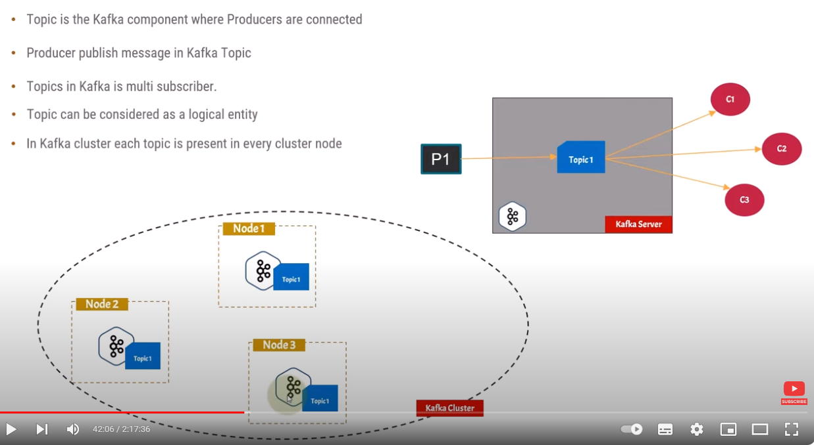

Slide 51
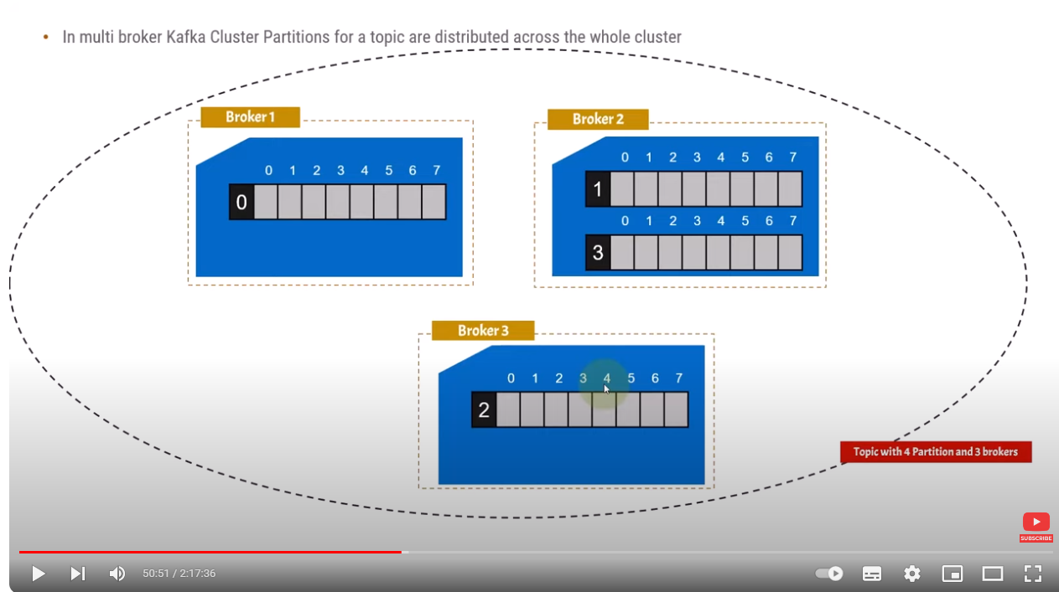

Slide 52
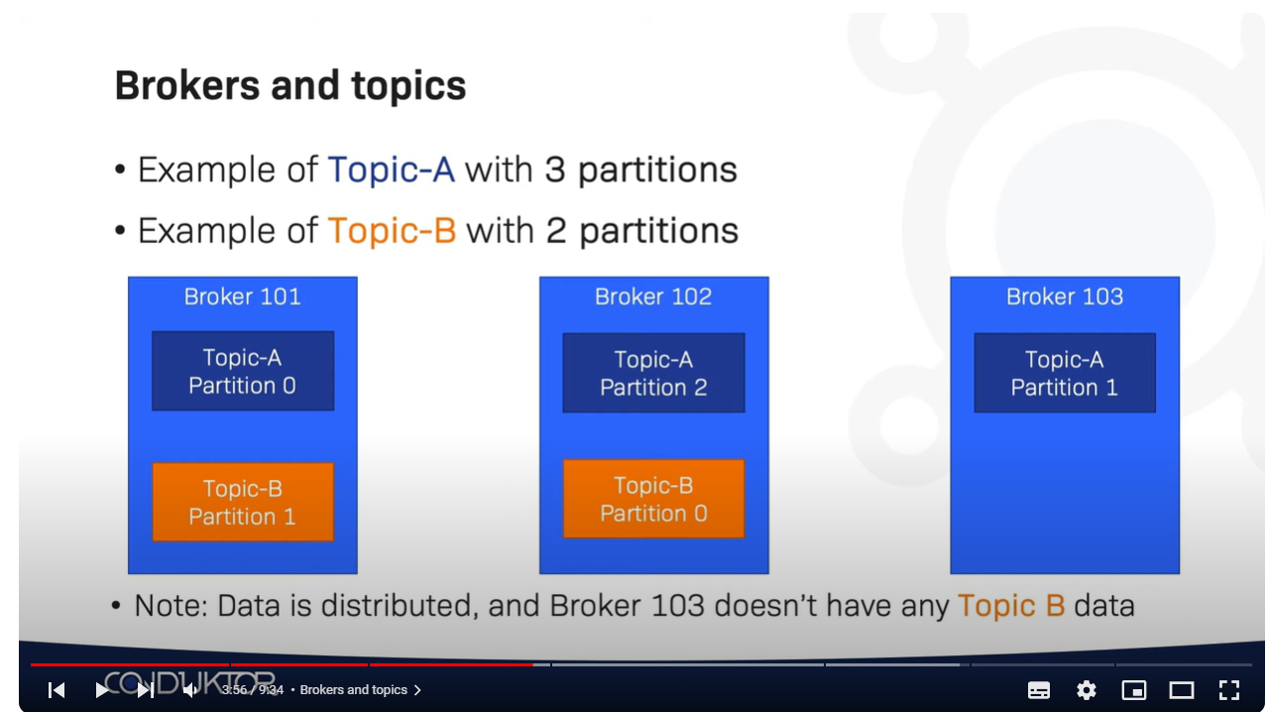

Slide 53
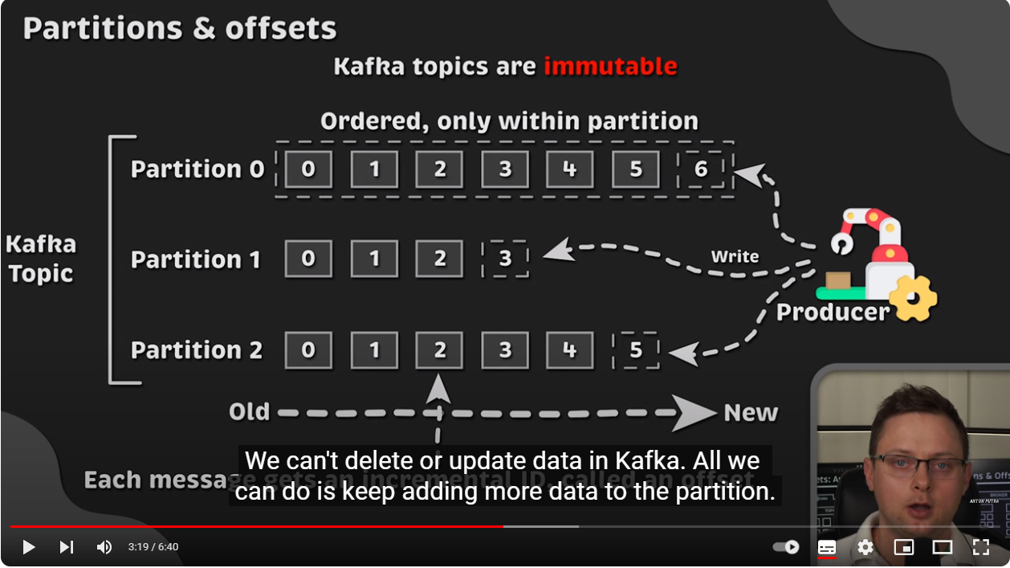

Slide 54
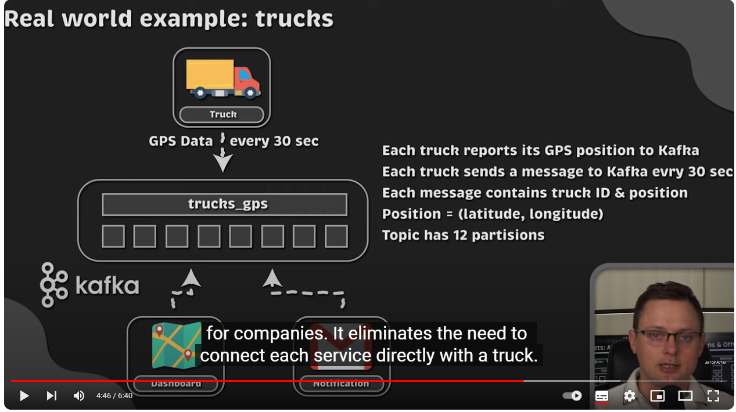

Slide 55
Kafka Server
Broker
Broker.id: 1
Topic
Partitions
Broker.id: 0
Broker
Broker
Broker.id: 2

Slide 56
Every broker has a unique identifier that is either set in the broker configuration file or automatically generated
Every time a broker process starts, it registers itself with its ID in Zookeeper by creating an ephemeral node
If you try to start another broker with the same ID, you will get an error: because we already have a Zookeeper node for the same broker ID
When a broker loses connectivity to Zookeeper (usually as a result of the broker stop‐ ping, but this can also happen as a result of network partition or a long garbagecollection pause), the ephemeral node that the broker created when starting will be automatically removed from Zookeeper.

Slide 57
The Broker Controller
Is responsible for electing partition leaders
The first broker that starts in the cluster becomes the controller by creating an ephemeral node in ZooKeeper called /controller
When other brokers start, they also try to create this node, but receive a “node already exists” exception
The brokers create a Zoo‐ keeper watch on the controller node so they get notified of changes to this node. This way, we guarantee that the cluster will only have one controller at a time.

Slide 58
When the controller broker is stopped or loses connectivity to Zookeeper, the ephem‐ eral node will disappear
Other brokers in the cluster will be notified through the Zookeeper watch that the controller is gone and will attempt to create the controller node in Zookeeper themselves
The first node to create the new controller in Zoo‐ keeper is the new controller, while the other nodes will receive a “node already exists” exception and re-create the watch on the new controller node

Slide 59
Replication
Replication is critical because it is the way Kafka guarantees availability and durability when individual nodes inevitably fail.
Data in Kafka is organized by topics. Each topic is parti‐ tioned, and each partition can have multiple replicas.
Those replicas are stored on brokers, and each broker typically stores hundreds or even thousands of replicas belonging to different topics and partitions.

Slide 60
There are two types of replicas
Leader replica: Each partition has a single replica designated as the leader. All produce and con‐ sume requests go through the leader, in order to guarantee consistency.
Follower replica: All replicas for a partition that are not leaders are called followers. Followers don’t serve client requests; their only job is to replicate messages from the leader and stay up-to-date with the most recent messages the leader has. In the event that a leader replica for a partition crashes, one of the follower replicas will be promoted to become the new leader for the partition.
Another task the leader is responsible for is knowing which of the follower replicas is up-to-date with the leader.

Slide 61
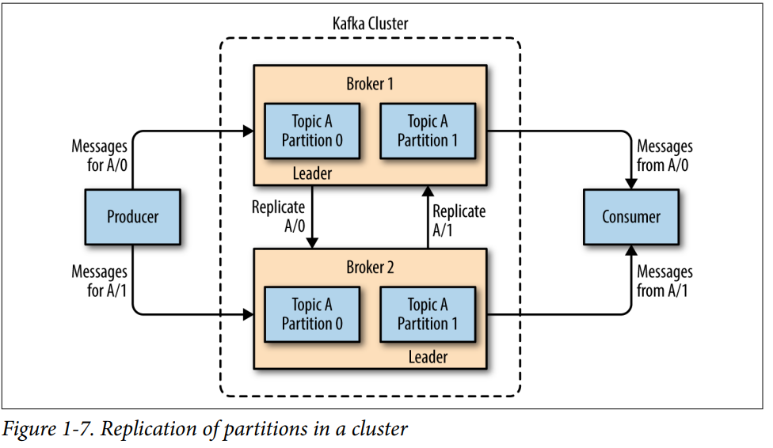

Slide 62
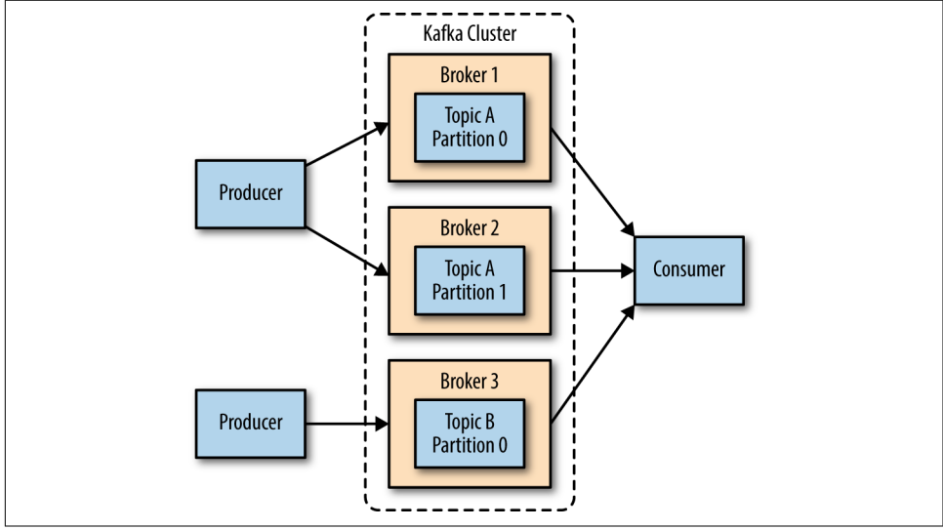
Replication always is implemented at the partition level (Not Broker or Topic Level: Just partition level)
The biggest benefit is the ability to scale the load across multiple servers. A close second is using replication to guard against data loss due to single system failures. Replication will also allow for performing mainte‐ nance work on Kafka or the underlying systems while still maintaining availability for clients

Slide 63
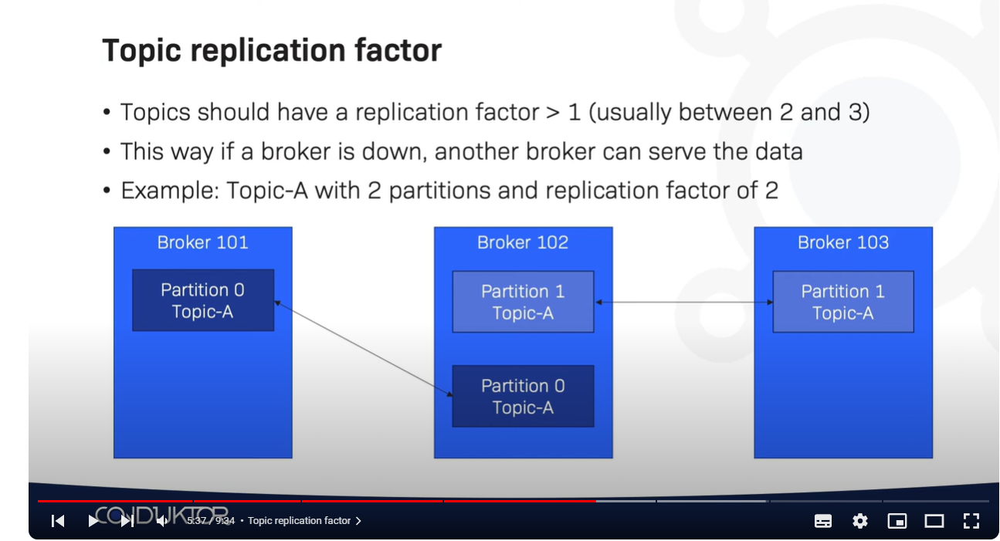

Slide 64
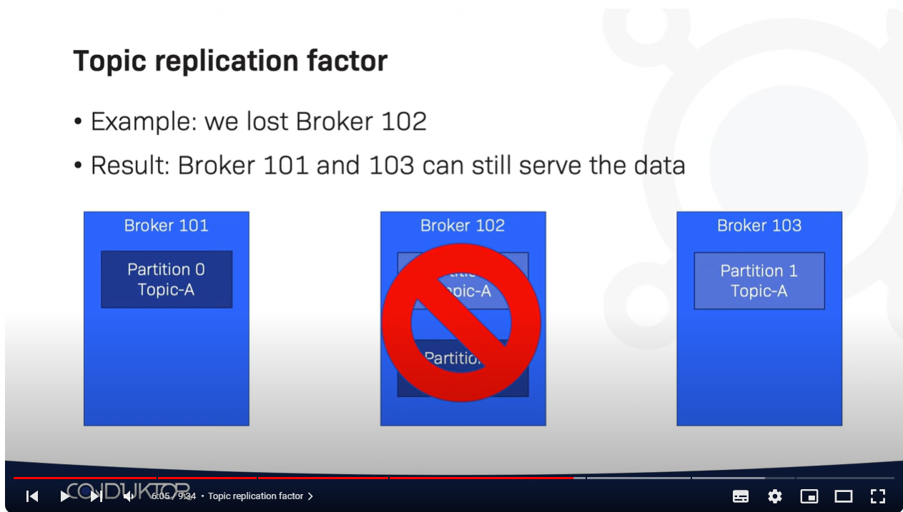

Slide 65
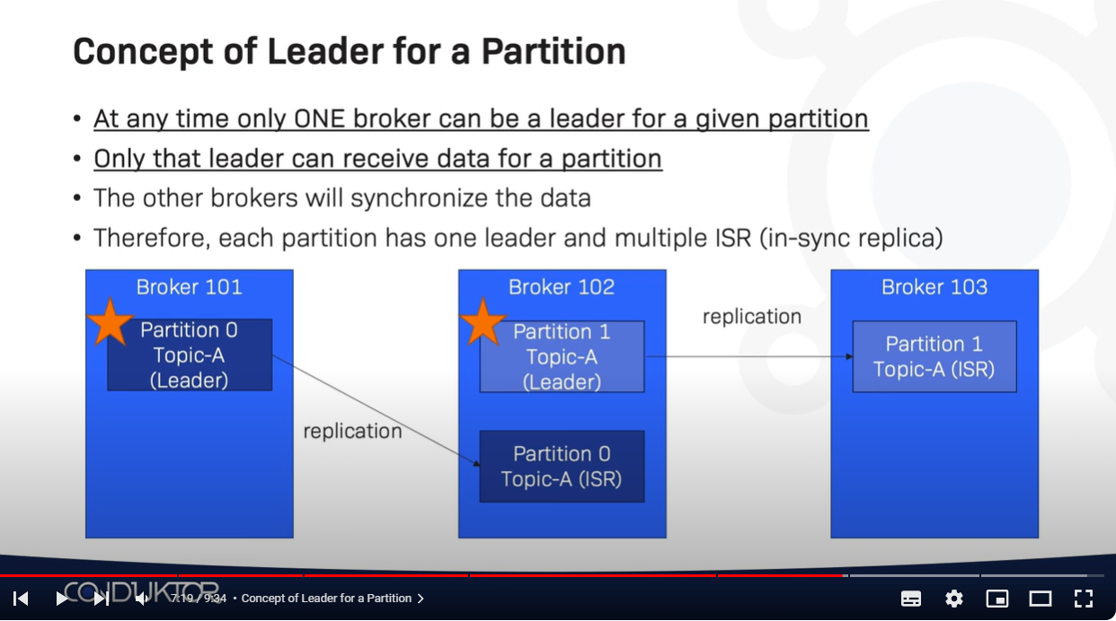

Slide 66
Retention
is the durable storage of messages for some period of time
Kafka brokers are configured with a default reten‐ tion setting for topics
Retaining messages for some period of time (e.g., 7 days)
Until the topic reaches a certain size in bytes (e.g., 1 GB)

Slide 67
Configuration Retention by time:
log.retention.hours, log.retention.minutes, log.retention.ms
All three of these specify the same configuration—the amount of time after which messages may be deleted but the recommended parameter to use is log.retention.ms
Default value: log.retention.hours=168 (one week)
Configuration Retention by size:
log.retention.bytes:
Another way to expire messages is based on the total number of bytes of messages retained
it is applied per-partition: This means that if you have a topic with 8 partitions, and log.retention.bytes is set to 1 GB, the amount of data retained for the topic will be 8 GB at most

Slide 68
Configuring Retention by Size and Time
If you have specified a value for both log.retention.bytes and log.retention.ms (or another parameter for retention by time), messages may be removed when either criteria is met. For example, if log.retention.ms is set to 86400000 (1 day) and log.reten tion.bytes is set to 1000000000 (1 GB), it is possible for messages that are less than 1 day old to get deleted if the total volume of mes‐ sages over the course of the day is greater than 1 GB. Conversely, if the volume is less than 1 GB, messages can be deleted after 1 day even if the total size of the partition is less than 1 GB

Slide 69
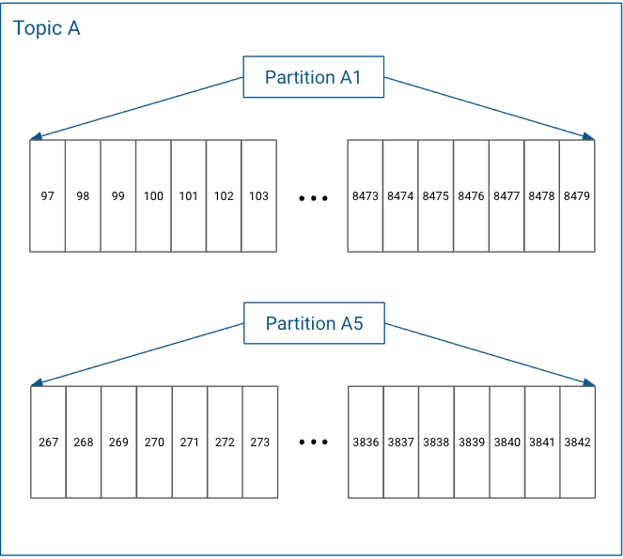
Configuring Retention by log segments by Size: log.segment.bytes
Partitions in Log Structured Format

Slide 70
In actuality, each partition does not keep all the records sequentially in a single file. Instead, it breaks each log into log segments. Log segments can be defined using a size limit (for example, 1 GB), as a time limit (for example, 1 day), or both. Administration around Kafka records often occurs at the log segment level.
Each of the partitions is broken into segments, with Segment N containing the most recent records and Segment 1 containing the oldest retained records. This is configurable on a per-topic basis.

Slide 71
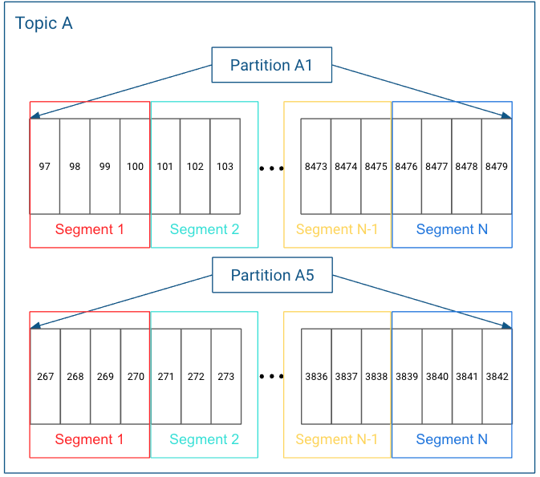

Slide 72
As messages are produced to the Kafka broker, they are appended to the current log segment for the partition. Once the log segment has reached the size specified by the log.segment.bytes parameter, which defaults to 1 GB, the log seg‐ ment is closed and a new one is opened. Once a log segment has been closed, it can be considered for expiration. A smaller log-segment size means that files must be closed and allocated more often, which reduces the overall efficiency of disk writes.
Adjusting the size of the log segments can be important if topics have a low produce rate. For example, if a topic receives only 100 megabytes per day of messages, and log.segment.bytes is set to the default, it will take 10 days to fill one segment. As messages cannot be expired until the log segment is closed, if log.retention.ms is set to 604800000 (1 week), there will actually be up to 17 days of messages retained until the closed log segment expires. This is because once the log segment is closed with the current 10 days of messages, that log segment must be retained for 7 days before it expires based on the time policy (as the segment cannot be removed until the last message in the segment can be expired).

Slide 73
Configuring Retention by log segments by Time: log.segment.ms
Another way to control when log segments are closed is by using the log.segment.ms parameter, which specifies the amount of time after which a log segment should be closed. As with the log.retention.bytes and log.retention.ms parameters, log.segment.bytes and log.segment.ms are not mutually exclusive properties. Kafka will close a log segment either when the size limit is reached or when the time limit is reached, whichever comes first. By default, there is no setting for log.seg ment.ms, which results in only closing log segments by size.

Slide 74
Configuring Kafka Brokers
message.max.bytes
The Kafka broker limits the maximum size of a message that can be produced, con‐ figured by the message.max.bytes parameter, which defaults to 1000000, or 1 MB. A producer that tries to send a message larger than this will receive an error back from the broker, and the message will not be accepted.

Slide 75
How Many Brokers For cluster
The appropriate size for a Kafka cluster is determined by several factors:
how much disk capacity is required for retaining messages and how much storage is available on a single broker
the capacity of the cluster to handle requests
Broker Configuration:
There are only two requirements in the broker configuration to allow multiple Kafka brokers to join a single cluster:
The first is that all brokers must have the same configuration for the
zookeeper.connect parameter (This specifies the Zookeeper ensemble and path where the cluster stores metadata)
The second requirement is that all brok‐ ers in the cluster must have a unique value for the broker.id parameter (If two brok‐ ers attempt to join the same cluster with the same broker.id, the second broker will log an error and fail to start.)

Slide 76
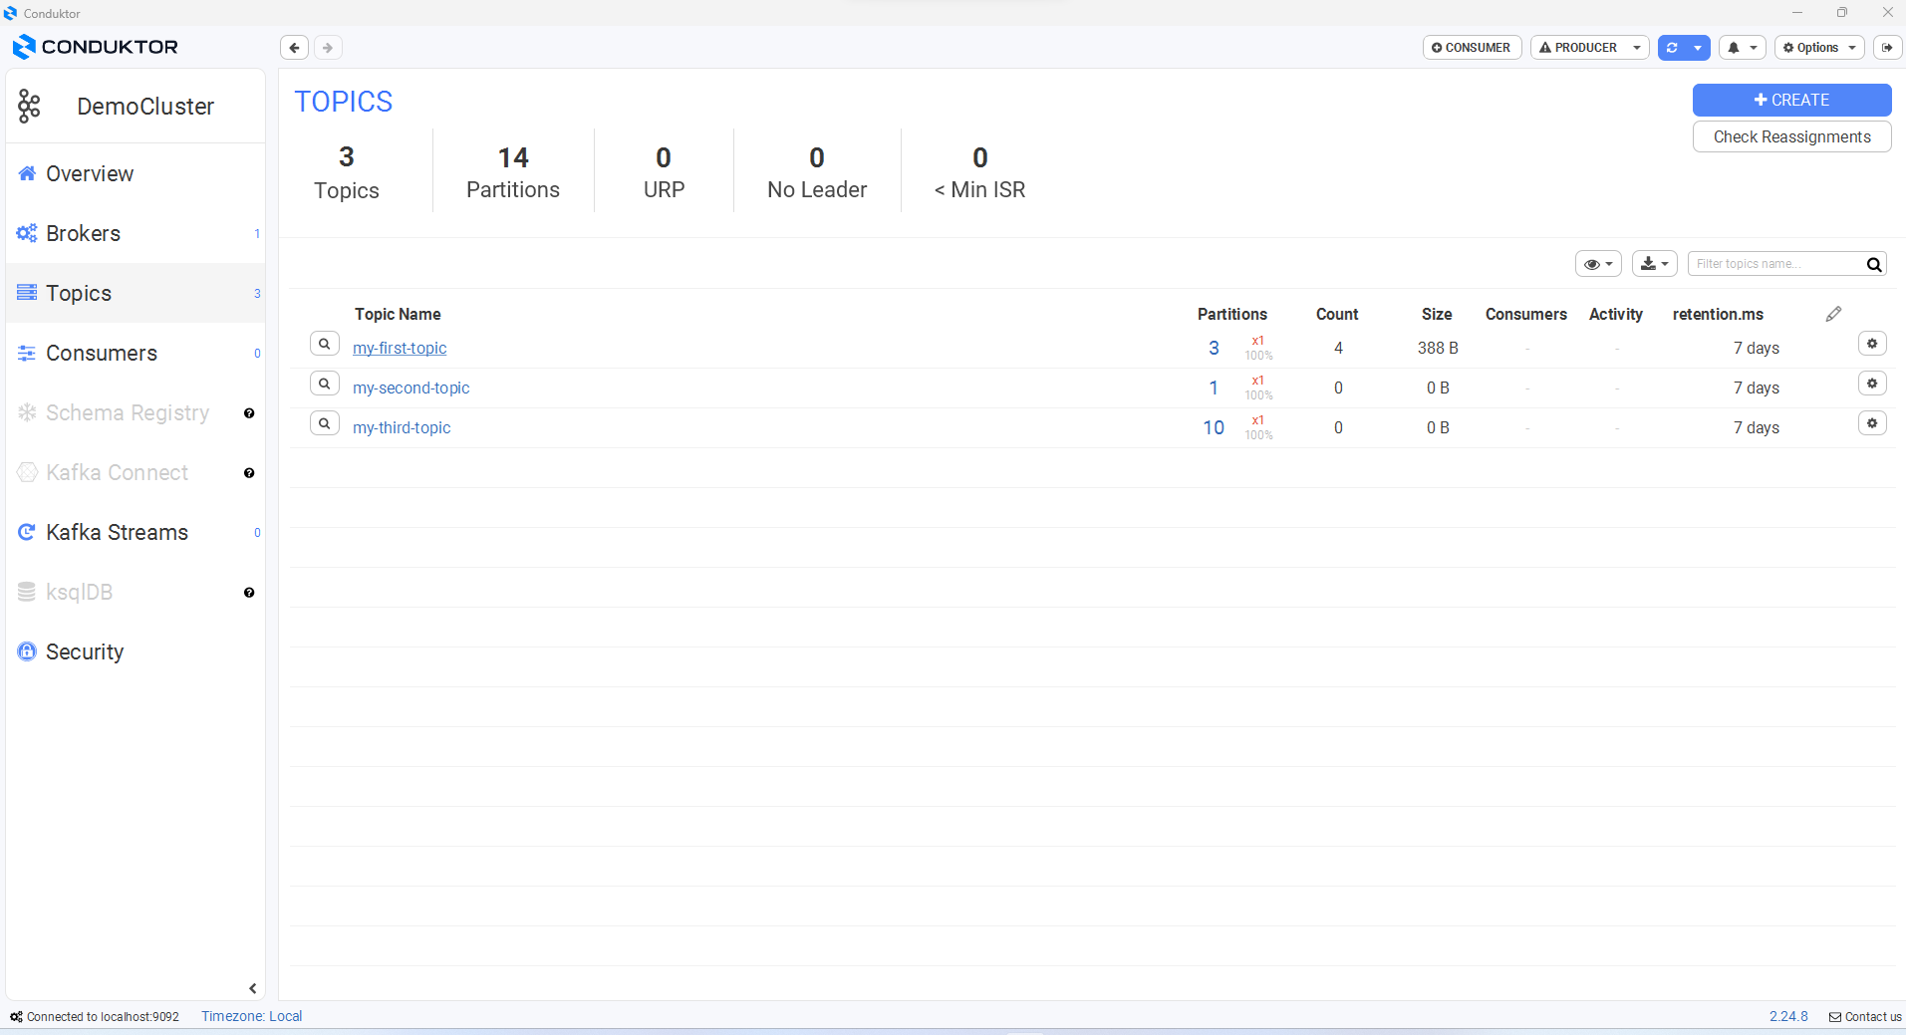

Slide 77
Producer

Slide 78
Producers create new messages. In other publish/subscribe systems, these may be called publishers or writers. In general, a message will be produced to a specific topic. By default, the producer does not care what partition a specific message is written to and will balance messages over all partitions of a topic evenly. In some cases, the pro‐ ducer will direct messages to specific partitions. This is typically done using the mes‐ sage key and a partitioner that will generate a hash of the key and map it to a specific partition. This assures that all messages produced with a given key will get written to the same partition.

Slide 79
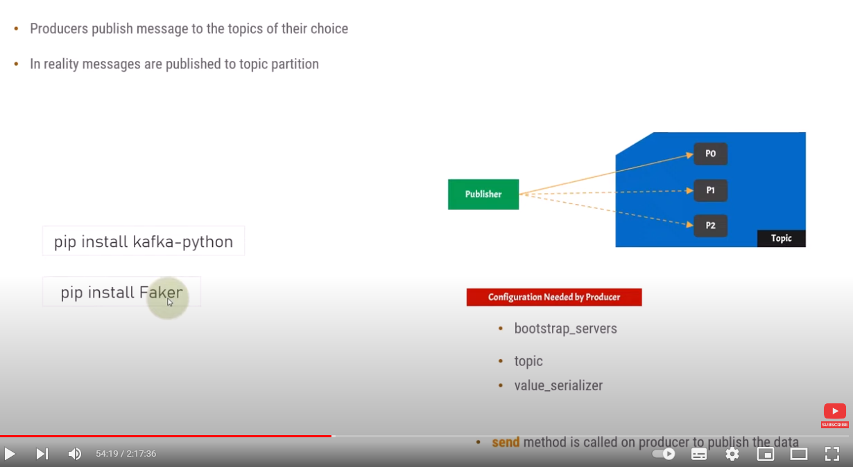

Slide 80
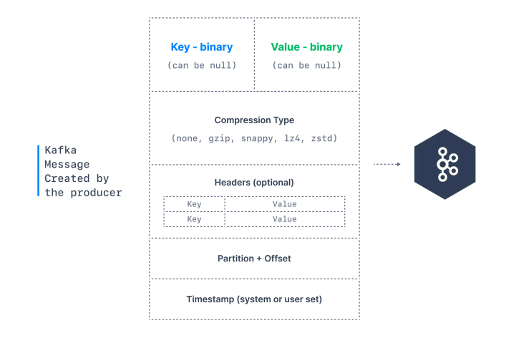
Send Message
(0)
Configuration Producer:
bootstrap.servers
key.serializer
value.serializer
Message * (Required) : Hello
Topic * (Required) : Greeting
Key (Optional) : key-message
Partition (Optional) : Partition0

Slide 81
ProducerRecord
Topic: Greeting
Message: Hello
(2) Serialize
ByteArrays
(3) Sent Message
Creation a Java object
Producer
Return
Broker (Server)
With Key
RecordMetadata
Topic
Partition
offset
Specific Partition
Return Error
Save
Successfully Written
Random Partition
Without Key
(round-robin algorithm)
Failed written
Save Message in Partition
Save
Exception

Slide 82
Configuration a Kafka Producer
A Kafka producer : Has three mandatory properties
bootstrap.servers: List of host:port pairs of brokers that the producer will use to establish initial connection to the Kafka cluster
key.serializer: Name of a class that will be used to serialize the keys of the records we will pro‐ duce to Kafka : implement “org.apache.kafka.common.serialization.Serializer”
value.serializer: Name of a class that will be used to serialize the values of the records we will pro‐ duce to Kafka : implement “org.apache.kafka.common.serialization.Serializer

Slide 83
Creating a Kafka Producer
private Properties kafkaProps = new Properties();
kafkaProps.put("bootstrap.servers", "broker1:9092,broker2:9092");
kafkaProps.put("key.serializer","org.apache.kafka.common.serialization.StringSerializer");
kafkaProps.put("value.serializer", "org.apache.kafka.common.serialization.StringSerializer");
KafkaProducer producer = new KafkaProducer<String, String>(kafkaProps);

Slide 84
There are three primary methods of sending messages
Once we instantiate a producer, it is time to start sending messages :
Fire-and-forget
We send a message to the server and don’t really care if it arrives succesfully or not. Most of the time, it will arrive successfully, since Kafka is highly available and the producer will retry sending messages automatically. However, some mes‐ sages will get lost using this method.
ProducerRecord<String, String> record = new ProducerRecord<>("CustomerCountry", "Precision Products", "France");
try {
producer.send(record);
} catch (Exception e) {
e.printStackTrace();
}
=> Topic name, Key, Value

Slide 85
Synchronous send :
We send a message, the send() method returns a Future object, and we use get() to wait on the future and see if the send() was successful or not.
ProducerRecord<String, String> record = new ProducerRecord<>("CustomerCountry", "Precision Products", "France");
try {
producer.send(record).get();
} catch (Exception e) {
e.printStackTrace();
}
using Future.get() to wait for a reply from Kafka. This method will throw an exception if the record is not sent successfully to Kafka
=> Topic name, Key, Value

Slide 86
Asynchronous send :
We call the send() method with a callback function, which gets triggered when it receives a response from the Kafka broker
private class DemoProducerCallback implements Callback {
@Override
public void onCompletion(RecordMetadata recordMetadata, Exception e) {
if (e != null) {
e.printStackTrace();
}
}
}
ProducerRecord<String, String> record = new ProducerRecord<>("CustomerCountry", "Biomedical Materials", "USA"); producer.send(record, new DemoProducerCallback());

Slide 87
Configuring Producers
acks
The acks parameter controls how many partition replicas must receive the record before the producer can consider the write successful. This option has a significant impact on how likely messages are to be lost
If acks=0, the producer will not wait for a reply from the broker before assuming the message was sent successfully. This means that if something went wrong and
the broker did not receive the message, the producer will not know about it and the message will be lost. However, because the producer is not waiting for any response from the server, it can send messages as fast as the network will support, so this setting can be used to achieve very high throughput.

Slide 88
If acks=1, the producer will receive a success response from the broker the moment the leader replica received the message. If the message can’t be written to the leader (e.g., if the leader crashed and a new leader was not elected yet), the producer will receive an error response and can retry sending the message, avoiding potential loss of data. The message can still get lost if the leader crashes and a replica without this message gets elected as the new leader (via unclean leader election). In this case, throughput depends on whether we send messages synchronously or asynchronously. If our client code waits for a reply from the server (by calling the get() method of the Future object returned when sending a message) it will obviously increase latency significantly (at least by a network roundtrip). If the client uses callbacks, latency will be hidden, but throughput will be limited by the number of in-flight messages (i.e., how many messages the pro‐ ducer will send before receiving replies from the server).

Slide 89
If acks=all, the producer will receive a success response from the broker once all in-sync replicas received the message. This is the safest mode since you can make sure more than one broker has the message and that the message will survive even in the case of crash. However, the latency we discussed in the acks=1 case will be even higher, since we will be wait‐ ing for more than just one broker to receive the message.

Slide 90
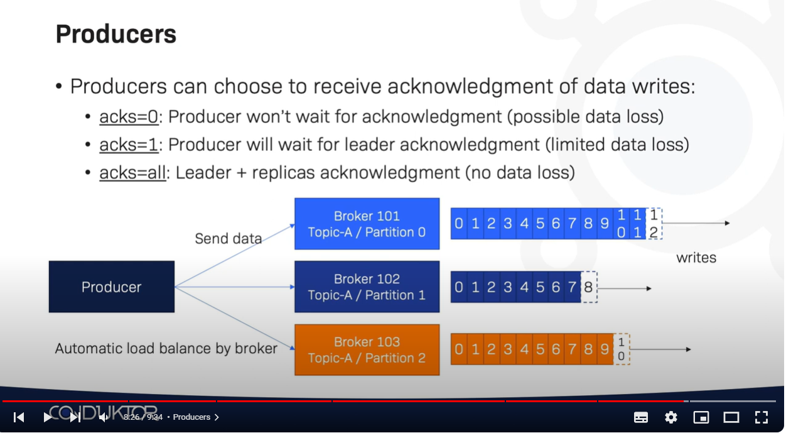

Slide 91
buffer.memory
This sets the amount of memory the producer will use to buffer messages waiting to be sent to brokers. If messages are sent by the application faster than they can be delivered to the server, the producer may run out of space and additional send() calls will either block or throw an exception, based on the block.on.buffer.full param‐ eter (replaced with max.block.ms in release 0.9.0.0, which allows blocking for a cer‐ tain time and then throwing an exception).
compression.type
By default, messages are sent uncompressed. This parameter can be set to snappy, gzip, or lz4, in which case the corresponding compression algorithms will be used to compress the data before sending it to the brokers. Snappy compression was invented by Google to provide decent compression ratios with low CPU overhead and good performance, so it is recommended in cases where both performance and bandwidth are a concern. Gzip compression will typically use more CPU and time but result in better compression ratios, so it recommended in cases where network bandwidth is more restricted. By enabling compression, you reduce network utilization and stor‐ age, which is often a bottleneck when sending messages to Kafka.

Slide 92
retries
When the producer receives an error message from the server
Parameter will control how many times the producer will retry sending the message before giving up and notifying the client of an issue
By default, the producer will wait 100ms between retries, but you can control this using the retry.backoff.ms parame‐ ter
max.block.ms
This parameter controls how long the producer will block when calling send() and when explicitly requesting metadata via partitionsFor(). Those methods block when the producer’s send buffer is full or when metadata is not available. When max.block.ms is reached, a timeout exception is thrown

Slide 93
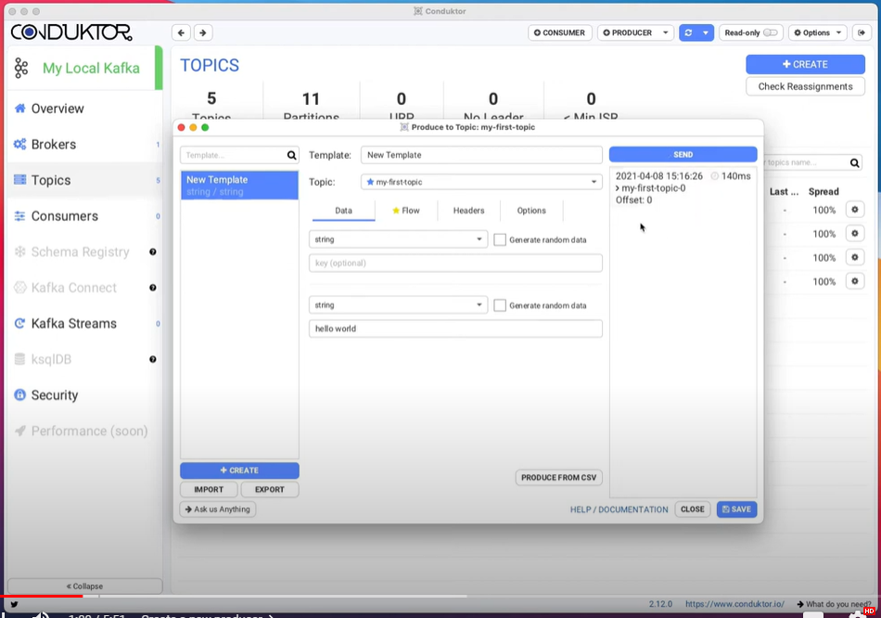

Slide 94
Consumers and Consumer Groups

Slide 95
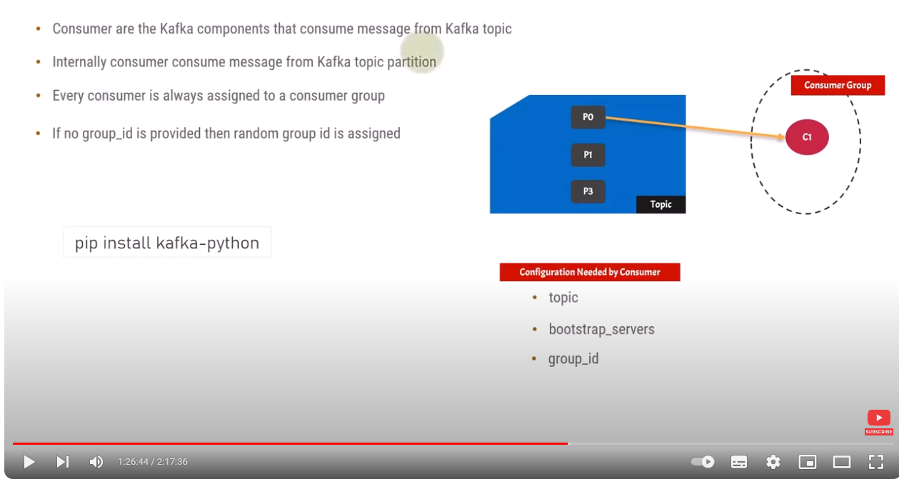

Slide 96
A consumer has to be associated with a Consumer Group: Every consumer is always assigned to a consumer group
-> If no group_id is assigned default, then random group is is assigned by Kafka
When multiple consumers are subscribed to a topic and belong to the same consumer group, each consumer in the group will receive messages from a different subset of the partitions in the topic

Slide 97
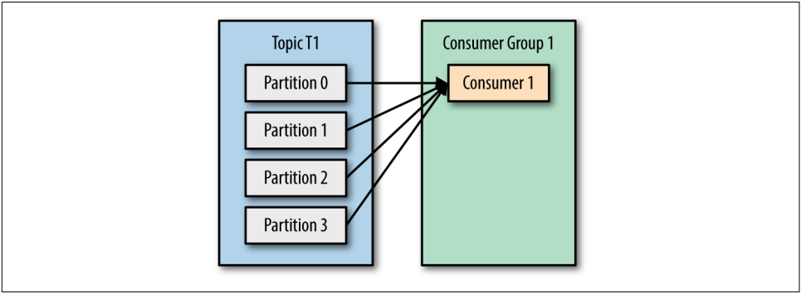
T1 with four partitions
C1 which is the only consumer in group G1 : will get all messages from all four t1 partitions

Slide 98
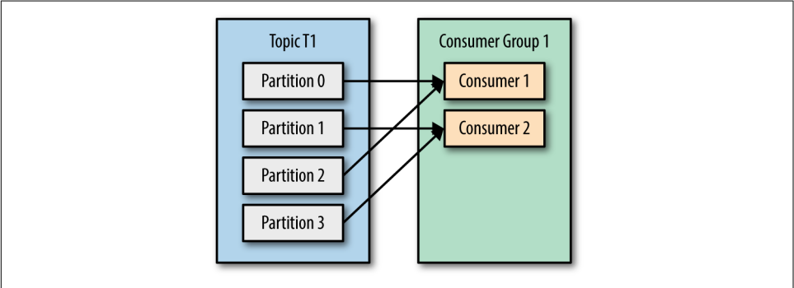
T1 with four partitions
C1,C2 consumers in group G1 :
=> each consumer will only get messages from two partitions
=> Perhaps messages from partition 0 and 2 go to C1 and messages from partitions 1 and 3 go to consumer C2

Slide 99
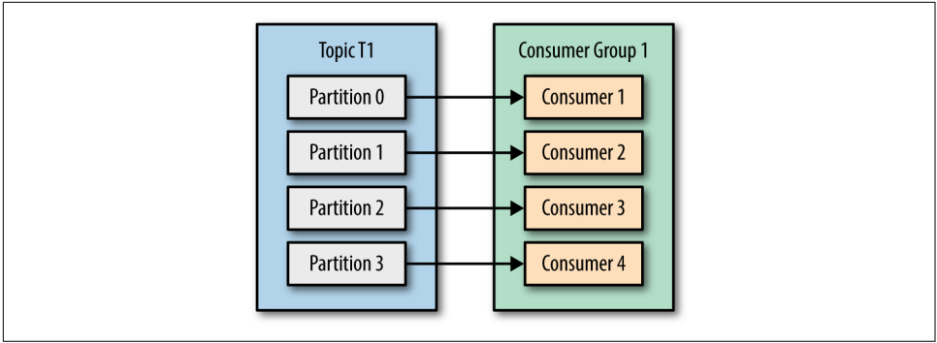
G1 has four consumers, then each will read messages from a single partition

Slide 100
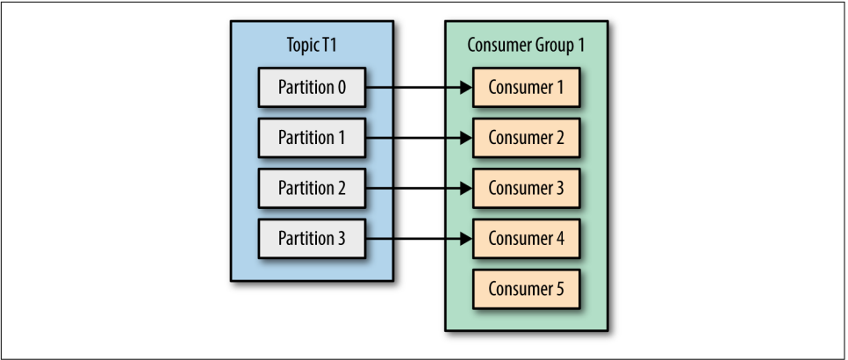
more consumers to a single group with a single topic than we have parti‐ tions,
=> some of the consumers will be idle and get no messages at all

Slide 101
The main way we scale data consumption from a Kafka topic is by adding more consumers to a consumer group.
It is common for Kafka consumers to do high-latency operations such as write to a database or a time-consuming computation on the data.
In these cases, a single consumer can’t possibly keep up with the rate data flows into a topic, and adding more consumers that share the load by having each consumer own just a subset of the partitions and messages is our main method of scaling.
This is a good reason to create topics with a large number of partitions—it allows adding more consumers when the load increases

Slide 102
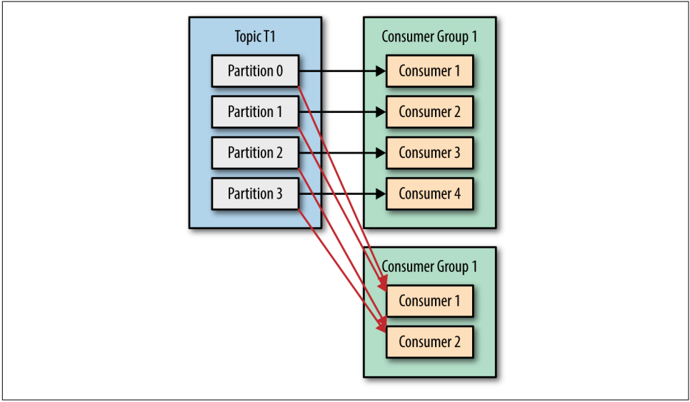
Unlike many traditional messaging systems, Kafka scales to a large number of consumers and consumer groups without reducing performance.

Slide 103
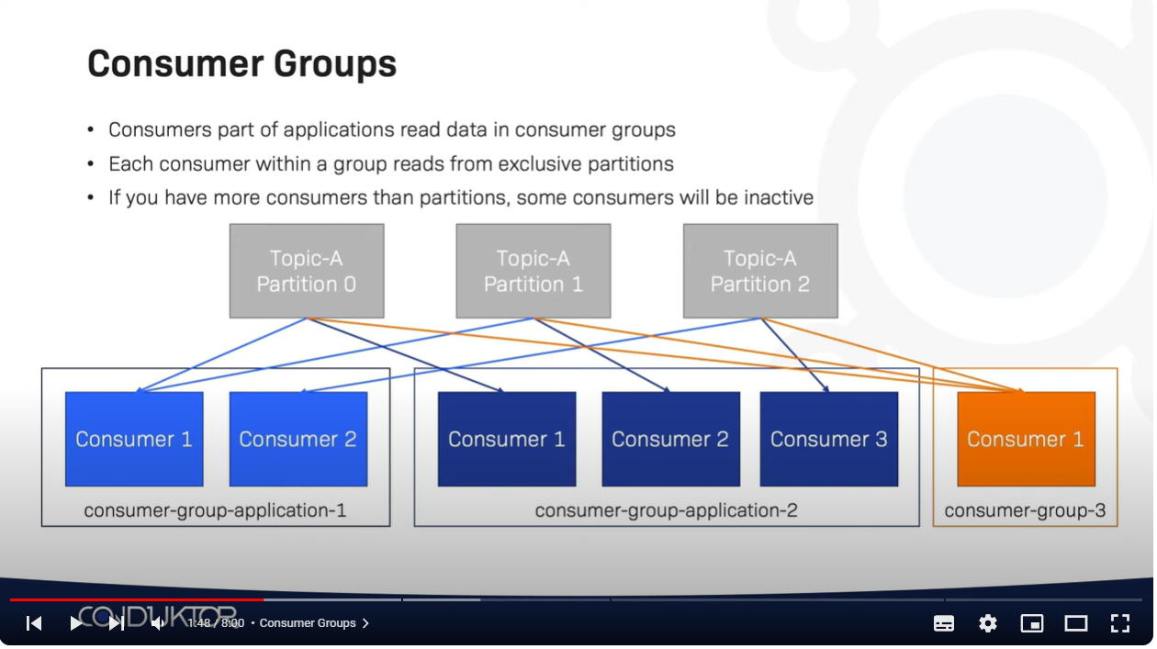

Slide 104
Consumer Groups and Partition Rebalance
When we add a new consumer to the group, it starts consuming messages from partitions previously consumed by another consumer
When a consumer shuts down or crashes; it leaves the group, and the partitions it used to consume will be consumed by one of the remaining consumers
Reassignment of partitions to consumers also happen when the topics the consumer group is consuming are modified (e.g., if an administrator adds new partitions)

Slide 105
Rebalances are important because they provide the consumer group with high availa‐ bility and scalability (allowing us to easily and safely add and remove consumers)
The way consumers maintain membership in a consumer group and ownership of the partitions assigned to them is by sending heartbeats to a Kafka broker designated as the group coordinator (this broker can be different for different consumer groups)
As long as the consumer is sending heartbeats at regular intervals, it is assumed to be alive, well, and processing messages from its partitions. Heartbeats are sent when the consumer polls (i.e., retrieves records) and when it commits records it has consumed

Slide 106
If the consumer stops sending heartbeats frequency for long enough, its session will time out and the group coordinator will consider it dead and trigger a rebalance (based on session.timeout.ms)
If a consumer crashed and stopped processing messages, it will take the group coordinator a few seconds without heartbeats to decide it is dead and trigger the rebalance
When closing a consumer cleanly, the consumer will notify the group coordinator that it is leaving, and the group coordinator will trigger a rebalance immediately, reducing the gap in processing

Slide 107
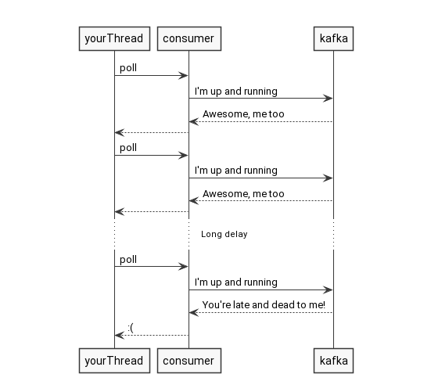
Crash
Consumer
Stoped Manualy

Slide 108
Configuration a Kafka Consumer
A Kafka consumer : Has three mandatory properties
bootstrap.servers: List of host:port pairs of brokers that the producer will use to establish initial connection to the Kafka cluster
key. deserializer: Name of a class that will be used to deserialize the keys of the records we will pro‐ duce to Kafka : implement “org.apache.kafka.common.serialization.Serializer”
value. deserializer: Name of a class that will be used to deserialize the values of the records we will pro‐ duce to Kafka : implement “org.apache.kafka.common.serialization.Serializer

Slide 109
Creating a Kafka Consumer
Properties props = new Properties();
props.put("bootstrap.servers", "broker1:9092,broker2:9092"); // Required
props.put("group.id", "CountryCounter"); // Optional
props.put("key.deserializer", "org.apache.kafka.common.serialization.StringDeserializer"); // Required props.put("value.deserializer", "org.apache.kafka.common.serialization.StringDeserializer"); // Required
KafkaConsumer consumer = new KafkaConsumer(props);

Slide 110
Subscribing to Topics
Once we create a consumer, the next step is to subscribe to one or more topics. The subcribe() method takes a list of topics as a parameter, so it’s pretty simple to use:
consumer.subscribe(Collections.singletonList("customerCountries"));
It is also possible to call subscribe with a regular expression
consumer.subscribe("test.*");

Slide 111
The Poll Loop
Once the consumer subscribes to topics, the poll loop handles all details of
Coordination,
Partition
Rebalances,
Heartbeats and data fetching
leaving the developer with a clean API that simply returns available data from the assigned partitions

Slide 112

body of a consumer will look as follows

Slide 113
poll() returns a list of records written to Kafka Broker that consumers in our group have not read yet
Each record contains the topic and partition the record came from, the offset of the record within the partition, and of course the key and the value of the record
The same way that sharks must keep moving or they die, consumers must keep polling Kafka or they will be con‐ sidered dead and the partitions they are consuming will be handed to another consumer in the group to continue consuming.
The parameter we pass, poll(), is a timeout interval and controls how long poll() will block if data is not available in the consumer buffer.
If this is set to 0, poll() will return immediately; otherwise, it will wait for the specified number of milliseconds for data to arrive from the broker.

Slide 114
Consumer Configuration
session.timeout.ms: the maximum time a Kafka broker will wait to receive the next heartbeat from a consumer in a consumer group
-> The amount of time a consumer can be out of contact with the brokers while still considered alive defaults to 3 seconds. If more than session.timeout.ms passes
without the consumer sending a heartbeat to the group coordinator, it is considered dead and the group coordinator will trigger a rebalance of the consumer group to
allocate partitions from the dead consumer to the other consumers in the group.
heartbeat.interval.ms: the interval between heartbeats sent by a Kafka consumer to the Kafka broker's group coordinator.
-> controls how frequently the KafkaConsumer poll() method will send a heartbeat to the group coordinator
-> heatbeat.interval.ms must be lower than session.timeout.ms and is usually set to one-third of the timeout value.
-> if session.timeout.ms is 3 seconds, heartbeat.interval.ms should be 1 second

Slide 115

partition.assignment.strategy:
We learned that partitions are assigned to consumers in a consumer group
PartitionAssignor is a class that, given consumers and topics they subscribed to, decides which partitions will be assigned to which consumer
Kafka has three assignment strategies:
RangeAssignor :

Slide 116

RangeAssignor: is the default strategy
This is useful to join records from topics that have the same number of partitions. This strategy will put all the consumers in an order of member_id assigned by the coordinator and after that, the partitions are assigned starting from the first consumer.

Slide 117

RoundRobinAssignor: works by assigning partitions to consumer instances in a round-robin fashion. It attempts to distribute the partitions evenly among the available consumers within a consumer group. It assigns partitions one by one in a circular order to the consumers until all partitions are distributed.

Slide 118

Commits and Offsets
Whenever we call poll(), it returns records written to Kafka that consumers in our group have not read yet. This means that we have a way of tracking which records were read by a consumer of the group
A kafka offset is a unique identifier for each message within a kafka partition.
It helps consumers keep track of their progress like how many messages each consumer has already consumed from a partition so far and where to start next from.
=> Please note, offset is unique only within a partition, not across partitions.
This way if the consumer crashes or gets replaced by a new one, the latest committed message offset will help it resume from the exact point where it was left.

Slide 119
Commit: action of updating the current position in the partition
Last committed message offset for the consumer for partition 0 is 4 while for partition 1 it is 3
KafkaConsumer API provides multiple ways of committing offsets
Automatic Commit:
The easiest way to commit offsets is to allow the consumer to do it for you. If you configure enable.auto.commit=true, then every five seconds the consumer will commit the largest offset your client received from poll()
We can set auto.commit.interval.ms property to change this default 5 seconds interval. Sample code snippet below with auto commit enabled with 1 second interval

Slide 120
Automatic Commit
public static void main(String[] args) {
Properties props = new Properties();
props.setProperty("bootstrap.servers", "localhost:9092");
props.setProperty("group.id", "test");
props.setProperty("enable.auto.commit", "true");
props.setProperty("auto.commit.interval.ms", "1000");
KafkaConsumer<Integer, AvroMessage> consumer = new KafkaConsumer<>(props, new IntegerDeserializer(), new AvroMessageDeserializer());
consumer.subscribe(Arrays.asList("myavrotopic"));
while (true) {
ConsumerRecords<Integer, AvroMessage> records = consumer.poll(Duration.ofMillis(100));
for (ConsumerRecord<Integer, AvroMessage> record : records) {
System.out.println("Received message: (" + record.key() + ", " + record.value().toString() + ") at offset " + record.offset());
}
}
}

Slide 121
Synchronous Commit
Auto commit is set to false in the below code snippet and we explicitly call consumer.commitSync() which will commit last offset returned by the poll method. Hence we need to make sure we call it after we are done processing all the message offsets returned by the last poll method.
props.setProperty("enable.auto.commit", "false");

Slide 122
public static void main(String[] args) {
Properties props = new Properties();
props.setProperty("bootstrap.servers", "localhost:9092");
props.setProperty("group.id", "test");
props.setProperty("enable.auto.commit", "false");
KafkaConsumer<Integer, AvroMessage> consumer = new KafkaConsumer<>(props, new IntegerDeserializer(), new AvroMessageDeserializer());
consumer.subscribe(Arrays.asList("myavrotopic"));
while (true) {
ConsumerRecords<Integer, AvroMessage> records = consumer.poll(Duration.ofMillis(100));
for (ConsumerRecord<Integer, AvroMessage> record : records) {
System.out.println("Received message: (" + record.key() + ", " + record.value().toString() + ") at offset " + record.offset());
}
try{
consumer.commitSync();
}catch (CommitFailedException e){
System.out.println("Commit failed due to : "+ e);
e.printStackTrace();
}
}
}

Slide 123
Asynchronous Commit
With asynchronous commit API, we just send the commit request and carry on. Here the application is not blocked due to asynchronous call nature.
props.setProperty("enable.auto.commit", "false");

Slide 124
Asynchronous Commit
public static void main(String[] args) {
Properties props = new Properties();
props.setProperty("bootstrap.servers", "localhost:9092");
props.setProperty("group.id", "test");
props.setProperty("enable.auto.commit", "false");
KafkaConsumer<Integer, AvroMessage> consumer = new KafkaConsumer<>(props, new IntegerDeserializer(), new AvroMessageDeserializer());
consumer.subscribe(Arrays.asList("myavrotopic"));
while (true) {
ConsumerRecords<Integer, AvroMessage> records = consumer.poll(Duration.ofMillis(100));
for (ConsumerRecord<Integer, AvroMessage> record : records) {
System.out.println("Received message: (" + record.key() + ", " + record.value().toString() + ") at offset " + record.offset());
}
consumer.commitAsync();
}
}

Slide 125
Commit for specific offsets
Committing the latest offset only allows you to commit as often as you finish process‐
ing batches. But what if you want to commit more frequently than that? What if
poll() returns a huge batch and you want to commit offsets in the middle of the
batch to avoid having to process all those rows again if a rebalance occurs? You can’t
just call commitSync() or commitAsync()—this will commit the last offset returned,
which you didn’t get to process yet.
All the methods we have discussed so far, they commit the latest offset returned by the last poll() method. What if a developer wants to take further control over it and commit more frequently in smaller batches than what poll returned. For such use case we can pass a map of partition to offset metadata to both commitSync() and commitAsync() APIs

Slide 126
public static void main(String[] args) {
Properties props = new Properties();
props.setProperty("bootstrap.servers", "localhost:9092");
props.setProperty("group.id", "test");
props.setProperty("enable.auto.commit", "false");
KafkaConsumer<Integer, AvroMessage> consumer = new KafkaConsumer<>(props, new IntegerDeserializer(), new AvroMessageDeserializer());
consumer.subscribe(Arrays.asList("myavrotopic"));
Map<TopicPartition, OffsetAndMetadata> offsetAndMetadataMap = new HashMap<>();
while (true) {
ConsumerRecords<Integer, AvroMessage> records = consumer.poll(Duration.ofMillis(100));
for (ConsumerRecord<Integer, AvroMessage> record : records) {
System.out.println("Received message: (" + record.key() + ", " + record.value().toString() + ") at offset " + record.offset());
offsetAndMetadataMap.put(new TopicPartition(record.topic(), record.partition()),
new OffsetAndMetadata(record.offset()));
consumer.commitSync(offsetAndMetadataMap);
}
}
}

Slide 127
Example Commit for specific offsets
If you are in the middle of processing a batch of records, and the last message you got from partition 3 in topic “customers” has offset 5000, you can call commitSync() to commit offset 5000 for partition 3 in topic “customers.” Since your consumer may be consuming more than a single partition, you will need to track offsets on all of them, which adds complexity to your code

Slide 128
private Map<TopicPartition, OffsetAndMetadata> currentOffsets = new HashMap<>();
int count = 0;
…
while (true) {
ConsumerRecords<String, String> records = consumer.poll(100);
for (ConsumerRecord<String, String> record : records) {
System.out.printf("topic = %s, partition = %s, offset = %d, customer = %s, country = %s\n", record.topic(), record.partition(), record.offset(), record.key(), record.value());
currentOffsets.put(new TopicPartition(record.topic(), record.partition()), new OffsetAndMetadata(record.offset()+1, "no metadata"));
if (count % 1000 == 0) (1)
consumer.commitAsync(currentOffsets, null); (2)
count++;
}
}
(1) Here, we decide to commit current offsets every 1,000 records. In your applica‐ tion, you can commit based on time or perhaps content of the records
(2) I chose to call commitAsync(), but commitSync() is also completely valid here.

Slide 129
How Do We Exit the poll loop
When you decide to exit the poll loop cleanly
When you decide to exit the poll loop, you will need another thread to call con sumer.wakeup(): can be done from ShutdownHook
Calling wakeup will cause poll() to exit with WakeupException
The WakeupException doesn’t need to be handled, but before exiting the thread, you must call consumer.close()

Slide 130
Closing the consumer will commit off‐ sets if needed and will send the group coordinator a message that the consumer is leaving the group.
The consumer coordinator will trigger rebalancing immediately and you won’t need to wait for the session to time out before partitions from the con‐ sumer you are closing will be assigned to another consumer in the group.

Slide 131

Shutdown Hook

Slide 132


Slide 133
Zookeper

Slide 134


Slide 135


Slide 136
Security
in Apache Kafka

Slide 137


Slide 138


Slide 139


Slide 140


Slide 141


Slide 142
Demo (Examples)

Slide 143


Slide 144


Slide 145
Code source

Slide 146


Slide 147

Random Partitions !

Slide 148


Slide 149
Demo with Code source

Slide 150


Slide 151


Slide 152


Slide 153


Slide 154


Slide 155


Slide 156


Slide 157


Slide 158


